Slide 1
Checking the Media
Notes:
NB to the Tutor / Presenter:
Some of the following slides have elements that don’t appear immediately, but on subsequent mouse clicks. Whenever notes are numbered, like so:
1.
2.
3.
… this means that the elements on the slide should be triggered / clicked when you reach 2, 3, etc.

Slide 2
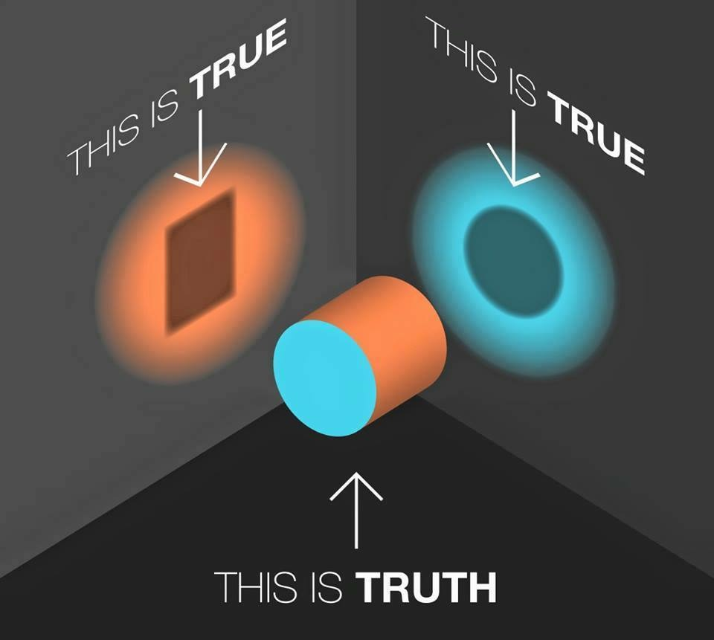
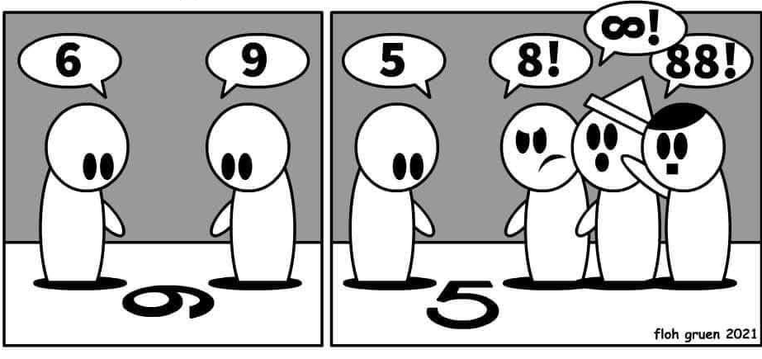
Notes:
1. Quality journalism aims to get as close as possible to the truth. Second best, to shine a light on it from different angles. Looking at the truth from just one angle - literally from one viewpoint - and attaching a value judgment to it is expressing an opinion… which is OK, as long as it is clearly marked as such (such as eg. commentaries, opinions in newspapers).
2. What is not OK is suggesting that a 5 is an 8…. Which it isn’t, no matter which way you look at it and no matter how many people are claiming it to be.
Discuss:
What do you think of the following statement?
A common understanding of our world is the basis of modern society. Without a common understanding of at least some basic truths, society falls apart.
Do you agree? Why / why not? How do some politicians (and media) purposely challenge this common basis of understanding and to what end?
(NB to the presentor: This is a tough question to start with, but it’s worth asking. If you have time, you can return to this slide and to this question at the end of the presentation and have a longer discussion including examples that the participants contribute from their countries (eg. when politicians didn’t accept an election result or denied wrongdoing despite being convicted in court). General examples that one could briefly discuss here are climate change or the Covid-19 pandemic (we will encounter both topics frequently during this presentation). For both Covid-19 and climate change, it is legitimate to discuss how big of a problem each is, what the implications are for society and what - if anything - can and should be done to fight it. This is the realm of political and social debate. However, it gets problematic if some parts of civilisation deny / dispute the measurements / facts themselves, ie. that temperatures are rising and that Covid-19 is a virus that can infect people. These facts have been researched and proven by others, as we cannot verify them by ourselves (and personal experience, eg. “I didn’t get sick despite everyone else having Covid-19” or “This Summer felt cooler than the ones before” may be misleading). I would argue that modern society relies on these (and other scientific, economic, social, etc.) discoveries being true, especially when they have been verified by a large group of experts all around the world and independently of one another… and that we should guide our decisions and policy making based on these findings (and not merely on our personal opinions.)

Slide 3
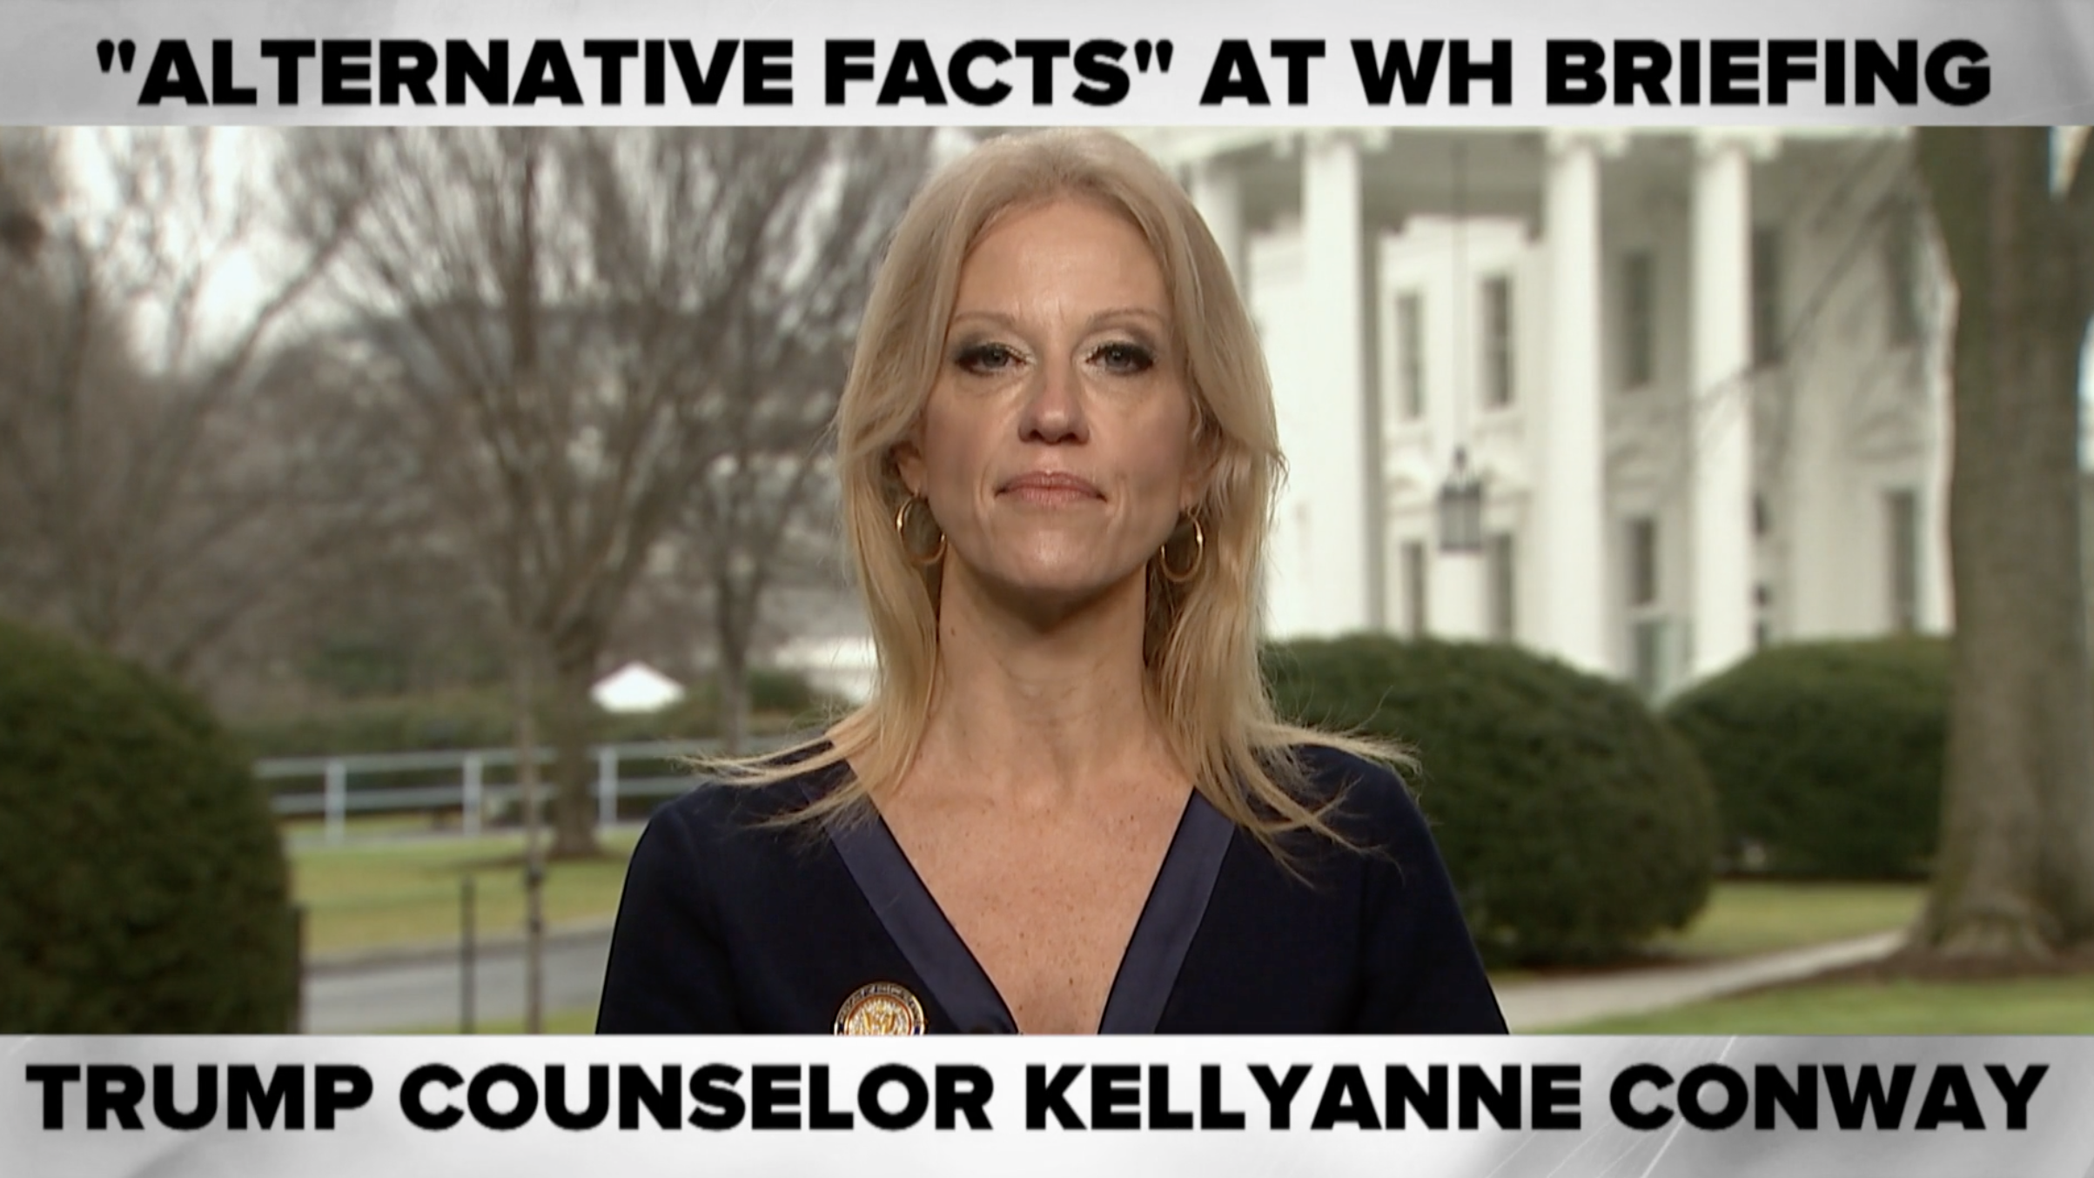
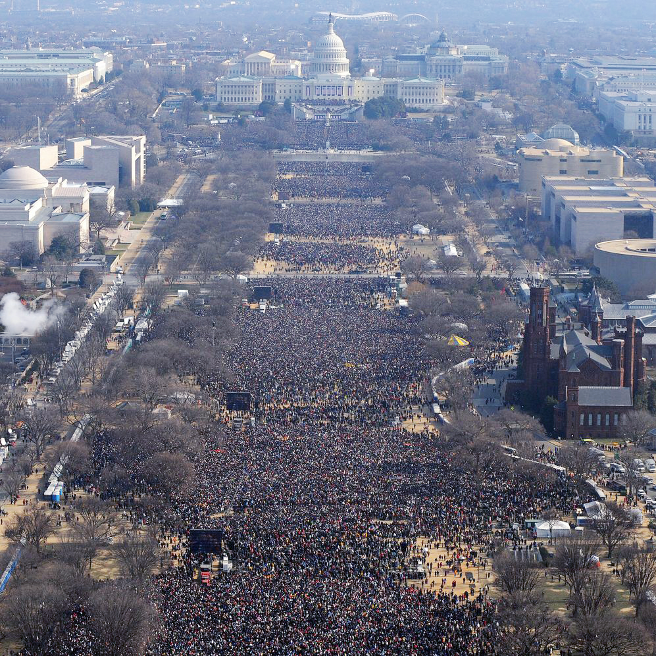
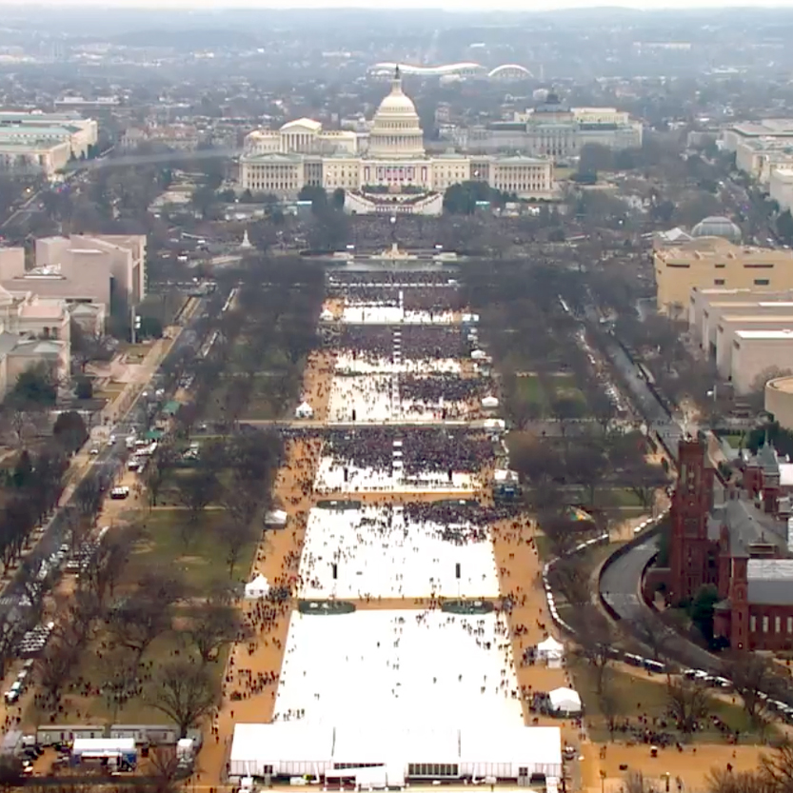
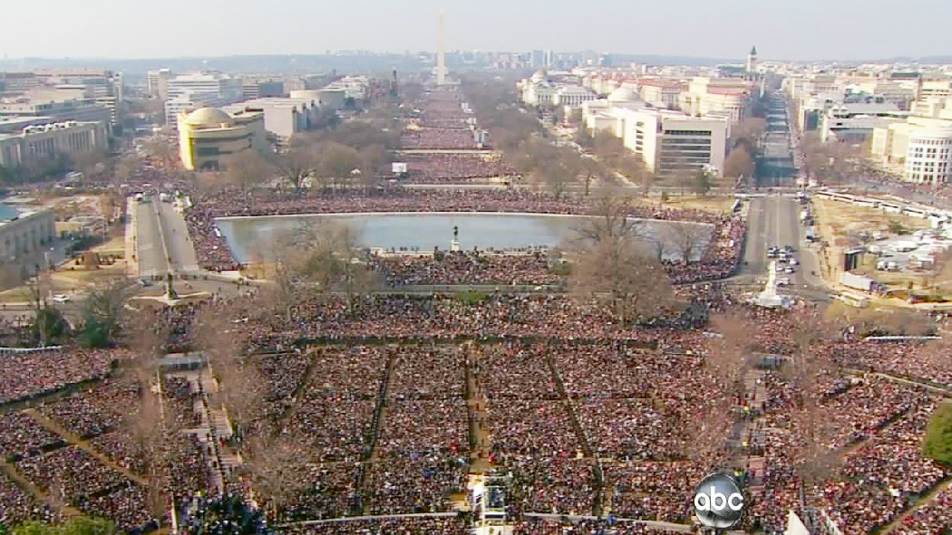
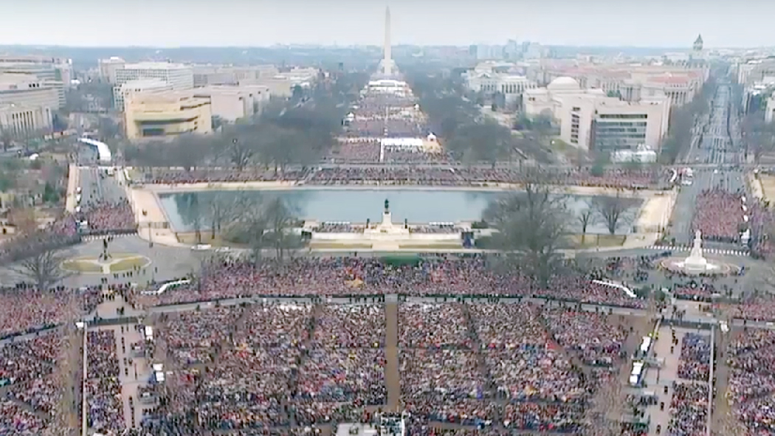
Obama 2009
Jewel Samad/AFP/Getty Images
Trump 2017
58th Presidential Inaugural Committee
Obama 2009
ABC News Footage
Trump 2017
58th Presidential Inaugural Committee
Notes:
“alternative facts” (Former Counselor to the President, Kellyanne Conway, on the 22nd of January 2017, referring to Sean Spencer, Former White House Press Secretary, saying Donald Trump’s inauguration ceremony saw "the largest audience ever to witness an inauguration, period”.)
For the sake of argument, what if Trump/Spencer/Conway were right? How do we know and how do we check? As a journalist, what would you do and what are some elements you could try to verify ? Check:
Were the photographs taken a the same time and are the sources credible?
Checks Photographs from other angles, satellite photography (it turns out that this approach fails, because it was cloudy on Trump’s inauguration day). Check:
Is the weather representation accurate, was it actually cloudy? Check: historic weather data, eg. here https://www.wunderground.com/history/daily/KDCA/date/2017-1-20
More things you could check as a journalist:
Get an expert estimate on crowd sizes; better: get more than one
Public transport data
As a consumer / reader, how do you check? Usually, with big events, journalists will have done the work for you and you only need to google. Compare different articles from different sources though, if you want to avoid media bias.
Sources:
https://www.nytimes.com/interactive/2017/01/20/us/politics/trump-inauguration-crowd.html
https://en.wikipedia.org/wiki/Inauguration_of_Donald_Trump

Slide 4
“You are entitled to your own views, but you are not entitled to your own facts”
- James R. Schlesinger
Notes:
Interestingly, there’s a debate about who said this sentence first and about how it was phrased exactly. As with many things, it is not easy to achieve a 100% certainty (especially, as in this case, when there are no direct video/audio recordings and/or you are reliant on secondary sources and/or a lot of time has passed - the first mention of this quote is from 1946).
However, in most cases, coming close to 100% is good enough (we also get on cars even though there is a 0.01% chance of dying in a car crash (over the course of a lifetime, statistics from USA, 2020)
https://quoteinvestigator.com/2020/03/17/own-facts/ )

Slide 5
The Challenge as a Media Consumer:
Finding the right balance between trust and critical thinking
Notes:
We cannot always check all the facts and sources. And after all, that’s what journalism is for… to do this work for us.
Austrian journalist Gerd Bacher (and former head of Austrian public television ORF) once said that the job of the journalist is to distinguish between true and not true, important and not important, sense and nonsense. Therefore, the journalist selects what to report and what not and acts as a kind of filter for the public, selecting what to report and what not (and we will look at some of these “selections” later).
At the same time, this filtering / selection process by journalists has come under increased criticism, frequently labelled as “what the mainstream media doesn’t want you to see”, suggesting that journalists or “mainstream media” deliberately hide something from you.
At the same time, a lot of information is being posted eg. on social media that does not adhere to journalistic standards such as fact-checking.
So, can and should we trust journalism?

Slide 6
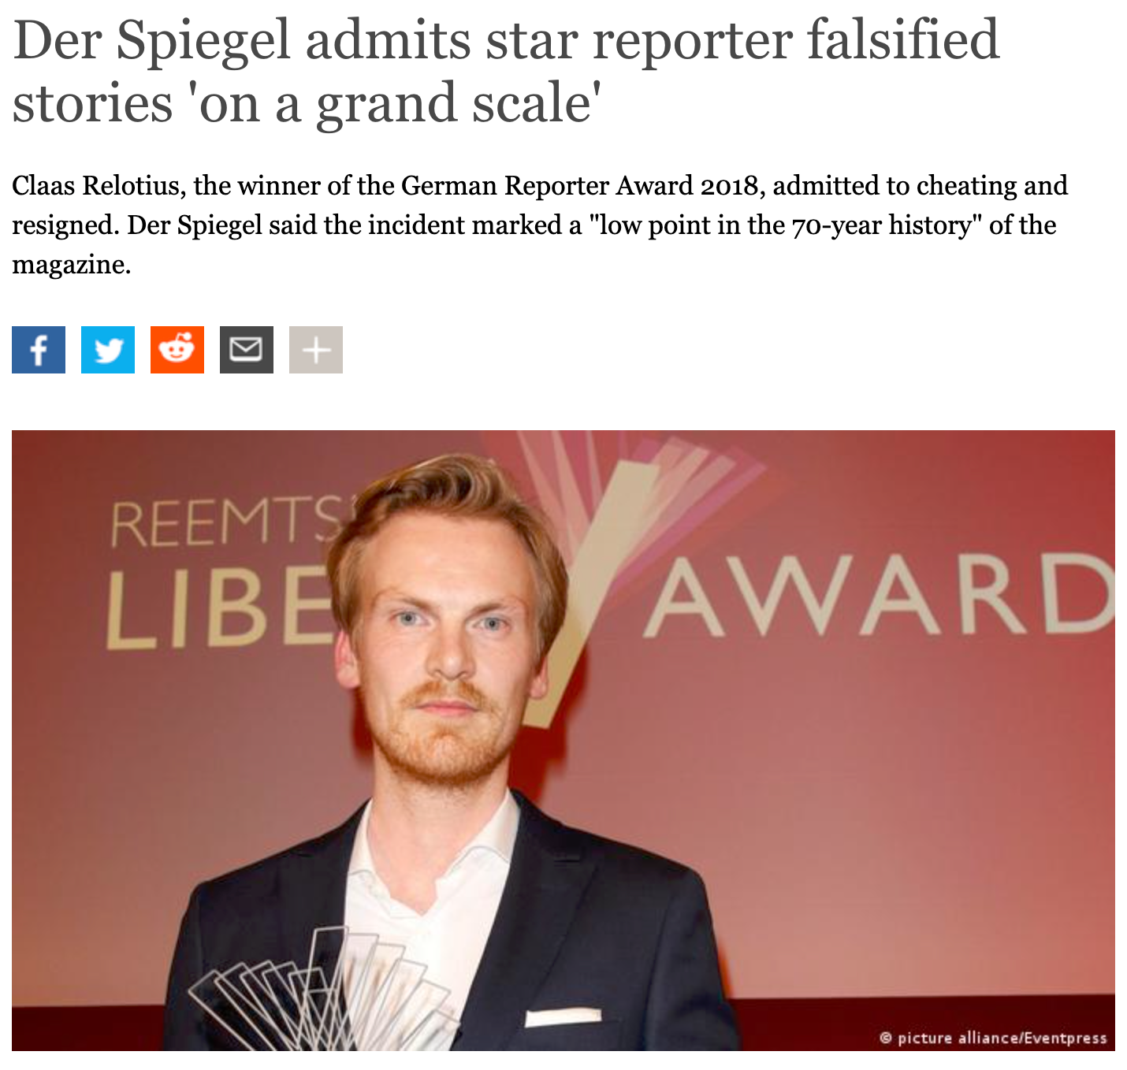
dw.com, 20.12.2018
Notes:
Discuss: Is this evidence towards the claim that all journalism is lies… or the contrary? or something in between?
I would say: the fact that it was discovered and that the Spiegel admitted it (additionally, it was an internal investigation by a colleague that lead to its discovery) is proof a system that works in most cases. (Nevertheless, it showed that the factchecking department of Spiegel needed to be improved and that they were blinded by the many rewards their star journalist had received… also, defunding / cost cutting had played a role - and we will see later how that is a big problem in journalism today.)

Slide 7
What does it mean to be critical of the media?
Notes:
Being critical of the media is not to say that media is all lies. It means maintaining a critical view on what we consume and watching out for red flags - especially if something triggers our emotions. And, if we are not sure that something is correct, double checking information with other sources or online verification tools (which we will look at later).

Slide 8
The good news:
It’s very difficult to ascertain if something is 100% true, but it is usually a lot easier to find out if something is false.
Notes:
In the case of Claas Relotius, his stories would have been difficult to verify by the reader because he reported on individual people’s stories (eg. a boy’s life in civil war Syria)… there are no readily available secondary sources that would be easy to check. But for the Spiegel, once they started looking into it, they found that he hadn’t even talked to some of the people and that personal details of his interviewees had been invented… so after some factchecking, it was quite easy to discredit.
As a media consumer, actual “news” is way easier to check, because usually there are multiple sources and an internet search comparing various articles on an issue will help you find out pretty quickly if something is straight up - wrong.
It’s different with opinions and evaluations of facts. There might be very different assessments of how to deal with unemployment (and what the “right” level of unemployment is for an economy), but we need to agree on the facts (the unemployment figures) in order to discuss possible solutions.

Slide 9
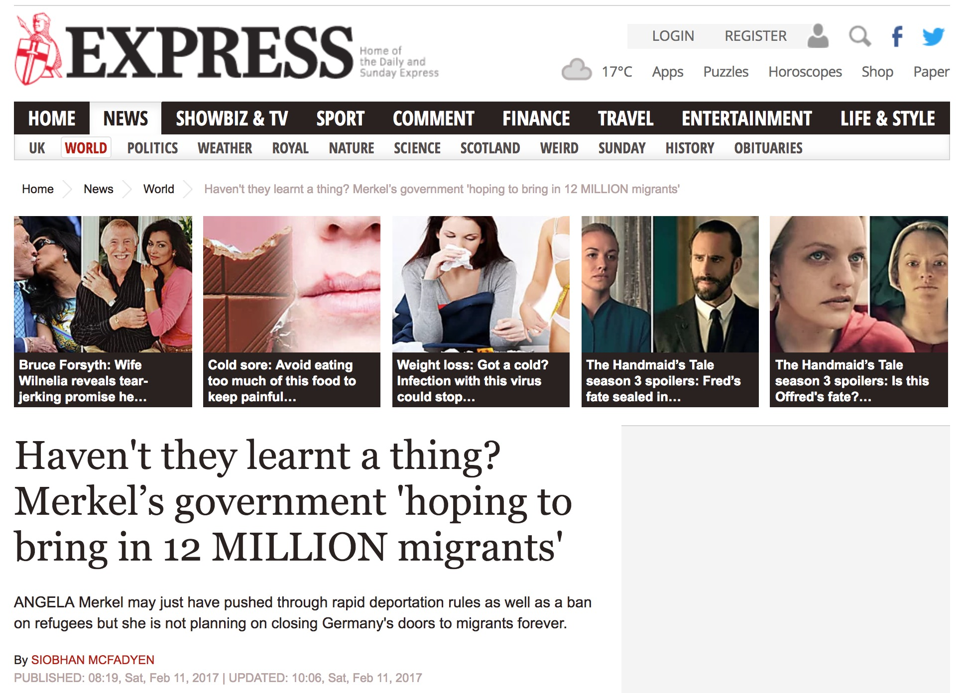
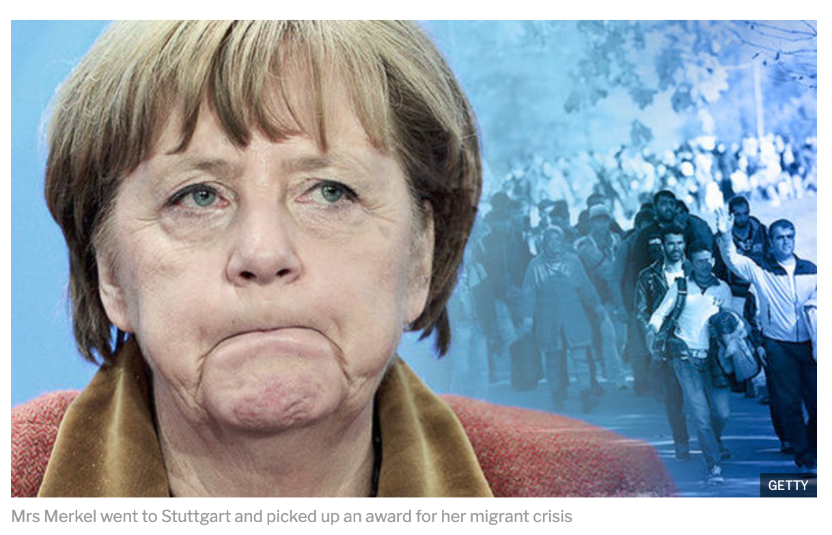
Notes:
1. So, what about this headline: Is this quality journalism?
How can you tell that this is poor journalism / highly opinionated?
Several clues in the text:
-opinion even before the quote: “haven’t they learnt a thing?”
-MILLION in all caps
-factual information missing: what about the time frame? it doesn’t say when, but the implication is immediately
-some of the other articles look like clickbait (clickbait: a headline (usually combined with an image) that catches the reader’s attention and aims to maximise the number of people clicking on it. In many cases, it cannot keep the promise of its headline and either tries to maximise time spent on a website and/or leads to advertorials (advertorials: articles that pretend to be journalism, but are actually selling a product).
2. Now the photo:
-the worst possible photo of Merkel
-a picture of the 2016 migrant wave was chosen to suggest that this is the kind of migration Merkel ist “hoping” for
- and the photo of Merkel is even missing attribution credit to the photographer… so it might be a montage / photoshopped image itself. (Even without photoshopping, the color correction was adjusted to make Merkel look pale and unhealthy)
The article claims that it is citing a secret German government document. How could you check if the quote is true?
Search “hoping to bring in 12 million immigrants” and Merkel.
Since this is about Germany, you find more information when you search it in German … and you will find factchecking websites that follow up on it (in Germany for example www.correctiv.de). Turns out:
The strategy paper isn’t secret, it’s published on a government site. It projects Germany’s population to decline due to a lowering birth rate. Until 2060, German population would remain stable, if 300.000 immigrants per year would come to Germany. This is a simple calculation and there is no indication of “hoping”.
As often with (borderline) fake news / bad journalism, there is a kernel of truth in it… but it gets distorted and framed to convey a different message.
Problem is: if you don’t like Merkel and/or if it confirms your world view, you are much more likely to believe it (confirmation bias) and talk about it to friends without critically assessing it.
Conclusion: Be wary if you feel that an article is pushing you towards a certain direction. The choice of words and framing here are red flags.
But how do you know that the factchecking website correctiv.de is legit? There are several factors, but the most important ones are that they are naming, quoting and linking directly to their sources, eg. the government paper. So you can check and read it yourself (provided you speak German).
https://correctiv.org/fakten-check/2018/03/05/nein-merkel-hofft-nicht-auf-12-millionen-einwanderer/

Slide 10
Identifying Quality Journalism
(things to look out for as reader / consumer)
referencing, quoting (and linking to) sources
factual language that avoids speculation, bias and emotions, otherwise labelled “opinion” or “commentary”
honouring ethics, such as the “right to reply”, presumption of innocence
mention of the author (initials or full name of journalist)
admitting and correcting errors
imprint and ownership are public and easily found
Notes:
So, we said that quoting (and ideally linking to) sources is a sign of quality journalism. What are other signs that you can watch out for?
- quoting (and linking to) sources
linking obviously works better in online texts (words will be underlined and linked) than in print, audio, video. (Main) Sources can (and should) still be referenced here.
- factual language that avoids bias and emotions, otherwise labelled “opinion or commentary”
it’s OK for journalists to have opinions, but articles must be labelled as such. “News” should not try to convince you of one point of view over another.
- honouring the “right to reply”
especially when one side is accused of something, good journalistic practice requires that you give them the “right to reply”, essentially a right to defend themselves. Quality journalism will also say if a side has “declined to reply”, indicating that the journalist tried, but didn’t receive a reply (within a given time frame)
admitting and correcting errors
everybody makes mistakes sometimes. Quality journalism will admit and correct these mistakes (eg. in the next issue of a print newspaper or correct it digitally online, while also indicating that the original article / video has been changed).
imprint and ownership are public and easily found
newspapers should show who prints and publishes the newspaper, websites will / should have a page and links to publishers & owners. If you see that the owner is eg. a political party or an oil company, this is a clue that the content might be biased. If there is no imprint at all or it is very hard to find, that is also a bad sign.

Slide 11
Sources for Journalists
Kind of Source
Quality of Source
people:
politicians, scientists, spokesperson, eyewitness, etc.
press releases, company reports, etc.
(scientific) studies
surveys
public data / statistics
own observation and/or measurements
books, other journalism, etc.
people:
multiple sources better than just one
named better than anonymous
best independent and no vested interest
first hand account
expertise
surveys:
sample size and confidence interval
who was asked and how were the questions phrased?
studies:
other studies confirming the results?
scientific standards (double blind, size of group, etc.)
Notes:
(NB: This slide should give a brief overview, but assessing the quality of sources could be a workshop in itself. Major points are only mentioned here without going into detail… )
Where are journalists getting their information from? What kind of sources are there?
It’s the journalists’ job to assess the quality of their sources (eg. scientific studies, books, their own observation) and also to not take everything at face value (eg. crosschecking a press release).
But also as reader/consumer, we can try to judge the quality of sources (and dive deeper if we are skeptical of the claims).

Slide 12
Journalism Best Practice
(aka. what do 99% of journalists strive for)
vs. Reality
(ie. why it doesn’t always work out)
Journalists aim to report…
…but are hindered by:
truthfully and accurately
fairly and balanced
independently
accountably
ethically (and lawfully?)
lack of time
lack of money
(access to (reliable)) sources
(political) influence
(subconscious) personal bias
lack of understanding
Notes:
(NB: Ask participants for suggestions before revealing the answers.)
In an ideal world, how do journalists strive to report:
1. truthfully and accurately
2. fairly and balanced
3. independently
- means they are not influenced by someone with a certain agenda (ownership, funding)
4. accountably
- means they take credit (and critique) for their work (usually by signing with their name or initials) and correcting mistakes (not just deleting them, but admitting that a mistake was made)
5. ethically
journalists should be aware of their power that comes with publication to great audiences. In criminal cases - presumption of innocence, respecting the personal sphere and personality rights (blurring a suspect). Also, reporting needs to be in the public interest - not everything that is true is worth reporting. Journalists need to abide by the law… but the law can be a limitation in countries not honouring the freedom of the press (eg. reporting on the Russia-Ukraine war was illegal in Russia in the beginning of 2022)
Real life hindrances are (discuss each):
6. lack of time
fast paced reporting, social media, etc. have increased the pressure to “be first” (which makes it difficult to apply journalistic due diligence: double-check the data, names and surnames, titles, and whether quotes are correct and accurately reflect what sources said and thought). More traditional media outlets are struggling to maintain high standards of reporting and keeping up with faster media that cares less about truthfulness.
the human brain is geared towards fast news and sensationalism. We can’t help it: alarming news catches our attention
Counterexample: eg. Slow Journalism, Delayed Gratification. (see next slide)
7. lack of money
- lack of money leads to lack of resources (too little staff, too little time, restricted access to fee-based resources). (also see the slide following the next)
8. (access to (reliable)) sources
- sometimes it’s just not possible to talk to the best sources… eg. in criminal cases or war reporting, you often can’t talk directly to the victim (eg. for victim protection or because the victim is dead); in corruption cases, people might not want to talk, whistleblowers might require anonymity, etc.)
9. (political) influence
- being funded by someone imposing a certain agenda (government funding, ownership structure); dependency on advertising (private or public!). Ideally, a media outlet is only funded by readership and independent state media funding… but few are.
10. (subconscious) personal bias
journalists are also humans… and we all have our personal beliefs and judgements about the world. No matter how objective we want or try to be, we will always lean towards focusing on facts that we agree with (confirmation bias)… good journalists will be less biased than others.
11. lack of understanding
Again, journalists are humans… and their understanding of a topic might be limited. Eg. when writing about science (eg. Covid-19), journalists aren’t scientists - they are the intermediary between the scientists and the public and try to translate scientific language into something that everyone understands. But of course, some things might get lost in translation… and journalists can make mistakes - especially, when they try to simplify complex matters.

Slide 13
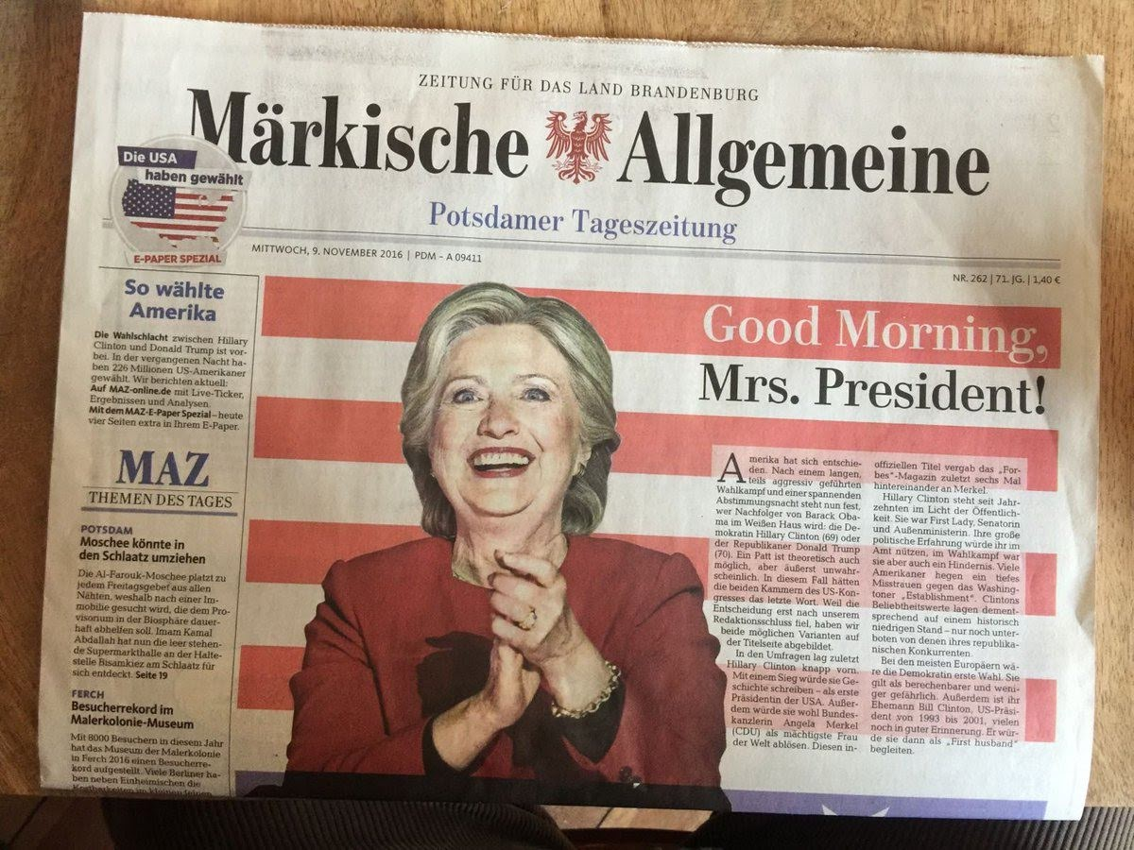
Notes:
An example: the problem with time and money.
This newspaper wanted to be (among the) first in reporting about Hillary Clinton’s victory in the 2016 US presidential election (which was expected, but as we now know didn’t happen), but they didn’t have the resources / money to wait with printing until the election results were in.
To be fair, they wrote in the text that they had gone to print before the results were in… still, an embarrassing mistake.

Slide 14
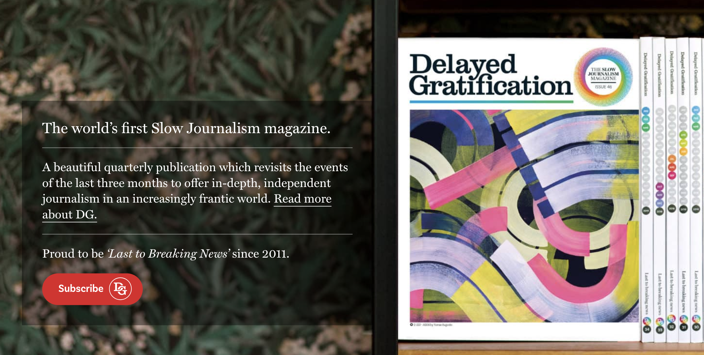
slow-journalism.com
falter.at
Notes:
Lack of Time
1. example of a magazine evading the pressure to be fast in reporting: “Delayed Gratification” - purposely choosing to report on stories three months old… thus better seeing what was really important… and how it progressed (not just how it started and then falling out of the media focus and you never know what happened next).
2. or “Falter” (Austrian Weekly Magazine): revisits stories at the end of the year and following up on what happened (after the majority of the media lost interest)
side note: of course it’s important to follow the news and everything that is happening around us, but taking some of the stress out of daily news consumption and turning our view more to mid and long term developments (eg. by (also) reading weekly and monthly magazines is helpful: a) for better understanding the big picture and b) for personal and mental wellbeing (mid- and long-term developments tend to be more positive than day to day news. See, as a famous example, the Factfulness Quiz and “why things are better than you think” https://factfulnessquiz.com/)

Slide 15
From 2016 to 2021, global advertising revenue for newspapers has been cut in half, according to a UNESCO report (2021). Meta (aka Facebook) and Google now receive more than 50% of all global digital advertising dollars.
This shift in advertising revenue has forced many newsrooms to reduce staff and, in some cases, close their doors. At the same time, the number of social media users has nearly doubled from 2016 to 2021— enabling more voices and greater access to content, but which has also led to quality journalistic and fact-based content being algorithmically downplayed.
https://en.unesco.org/news/unesco-calls-global-support-independent-journalism-amid-funding-crisis-media
Notes:
Lack of Money
this is a massive change that happened only over the last five years… and the funding situation in 2016 wasn’t great either.

Slide 16
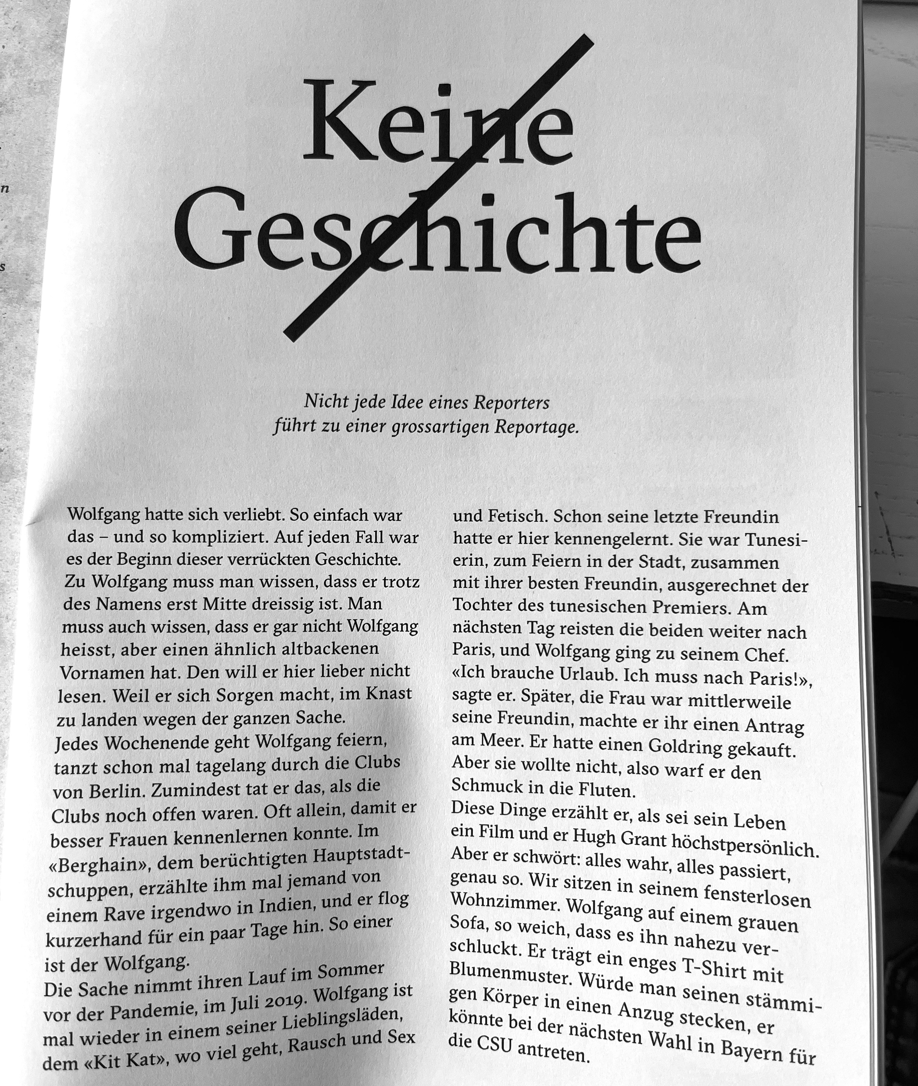
reportagen.com
Notes:
Lack of Money:
Due to money (and time) pressures, magazines (and journalists) are often pressured to turn everything they research into a story. But sometimes a hypothesis for a good story turns out not to be one after looking into it (eg. allegations of corruption might turn out to be false … or unverifiable). Swiss magazine “Reportagen” (also: no advertisement, only funded by readership) admits when a story has gone nowhere: “Keine Geschichte” means “No Story”.

Slide 17
Different Types of Information
(and how it is used in journalism)
Notes:
Measurements/facts/observations/statements are being turned into journalistic stories every day.
Let’s look at different types of information by using the example of climate change.
DATA: Weather stations all around the world gather data on air composition and pollution, satellite data, historic data (weather records), probes (eg. from trees, arctic ice), etc. This data usually doesn’t get published by itself, it requires analysis and sorting.
SORTED: Scientific reports and journals will usually present this information grouped, eg. by country / region or temperature or CO2 level, etc… or go on to the next stage, in which the data is arranged:
ARRANGED: Newspapers or TV news will usually present data in this way… arranging the data enables comparison between the groups. where are CO2 levels highest? a way that makes sense and allows comparisons, but with little story.
EXPLAINED WITH A STORY: Magazines, TV reports will usually base their story on facts and find real life examples to convey them to the audience. This appeals most to how we and our brains process and understand information, because they trigger empathy and emotions and we can identify with people better than with data. Eg. the farmer who lost his crop because of high temperatures or flooding.
The problem: you cannot tell ALL the stories of every farmer in the world. So good journalists need to pick good, representative examples and not outliers. Selecting outliers (eg. the one farmer who suffered most, or farmers profiting from climate change) is OK if it is clear to the viewer / reader that this is the story and if these examples are not being portrayed as representative of the bigger picture (eg. climate change is actually helping farmers worldwide).
When scientist and/or journalists refine data (sorting, arranging, telling a story), they are selecting to highlight some information and disregarding other. Ideally, the choice what to select will come from the data itself (eg. increase in average temperature due to global warming), but sometimes it is not so clear what to select and which story to tell. The choice will depend on the scientist’s / journalist’s preferences and personal beliefs… and in the worst case, it can lead to misleading “cherry picking”.
In social media, “cherry picking” to confirm one’s theory is even more common.
So now, we will look at the power of selection, framing and cherry picking with some examples.

Slide 18
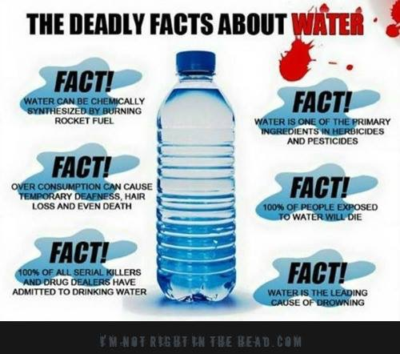
Notes:
1. Guess what the deadly substance is!
2. Answer: water.
Is this fake news?
Yes and no. Clearly, none of the facts are wrong. But they have been selected / “cherry picked” and framed in such a way as to mislead the reader into believing that water is something dangerous / deadly. This might not be fake news, but it is definitely misleading. (As we will see, only a tiny portion of “fake news” is really completely false. In many cases, it is based in some truth, but misrepresents it in such a way as to mislead the audience).
In this case, no one will be harmed, because everybody knows water isn’t harmful. But if this were about something else that you have less personal experience with you can see how this might influence people into believing it.

Slide 19
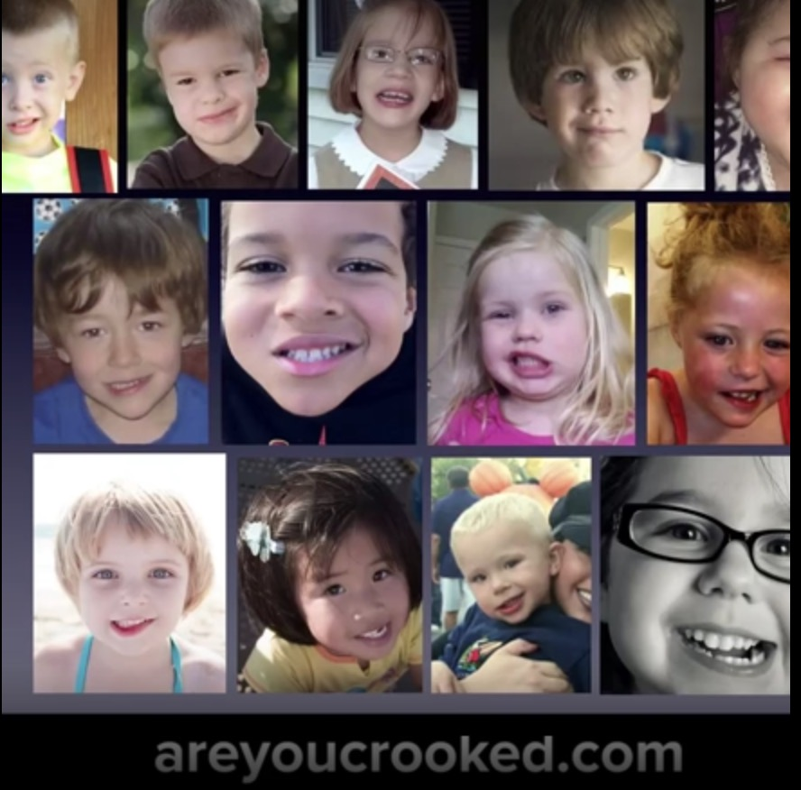
Notes:
Selection: If you take a photo at the right (or wrong) moment and then only pick the photos matching your criteria, you can create the impression that all children nowadays have crooked mouths or teeth.
This website wants to make us believe that people’s faces used to be symmetrical… and now they are crooked…. and says vaccines are the reason for it.
Also, they’re selling the book: http://areyoucrooked.com/

Slide 20
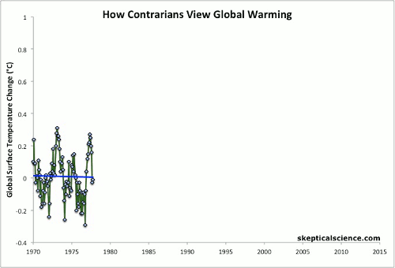
Notes:
1. So let’s return to climate change…
2. The graph shows the data… but if you you select only certain time periods, you could generate the impression that temperature isn’t rising after all

Slide 21
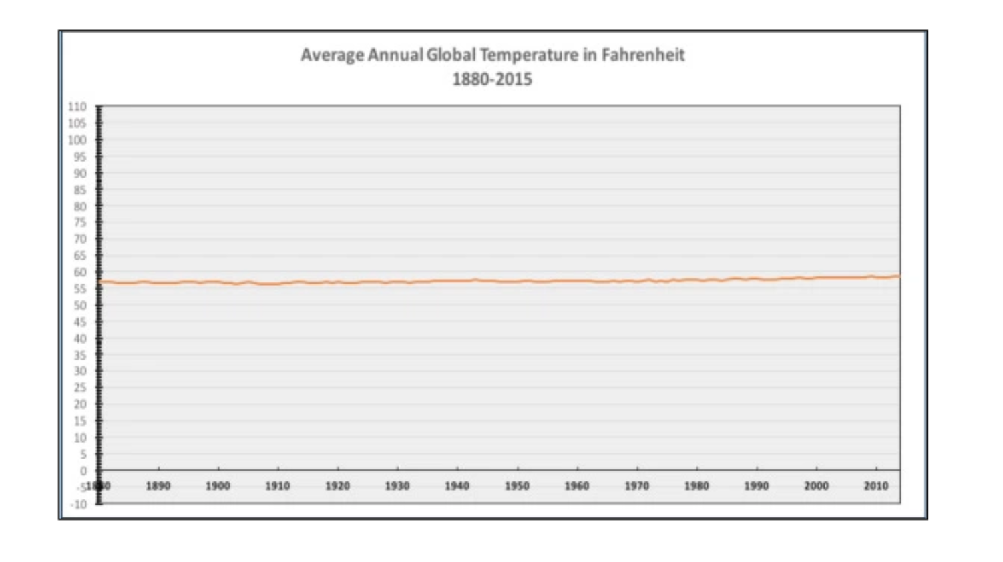
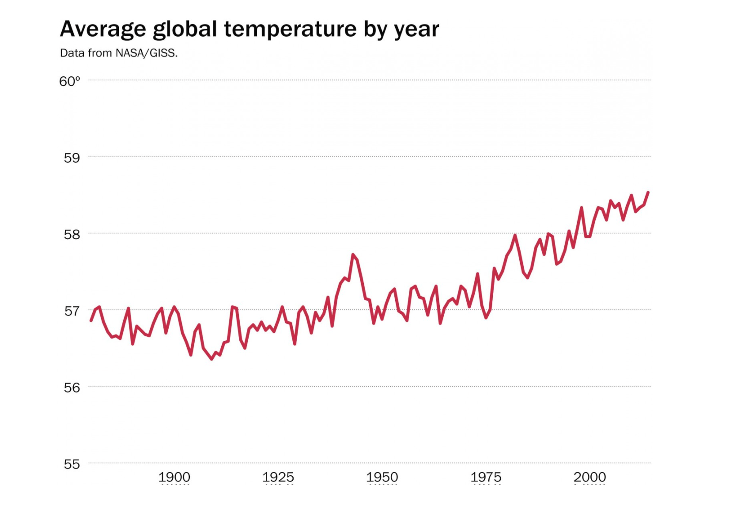
Notes:
1. Also, you could change the scale… if you make the y-axis too large (diagram on the left) the change in temperature is small in comparison and looks like a straight line and thereby not alarming at all.
This is is an objectively poor choice for the scale of the y-axis. Why? Because it is not relevant. The temperature doesn’t need to change by 20 degrees Fahrenheit or more in order to have a great impact on the world and life on earth.
2. The graph and scale on the right make more sense here and also show the trend.
While I would say that the choice of y-scale on the left is poor, the scales on the right are also subject to interpretation. If eg. you were to make the distance between the years on the x-axis shorter, the line would look steeper (and thus more dramatic)… and this would be a subjective choice. As reader, you would be influenced by the steepness of the curve but probably not question the choice of spacing along the x-axis.

Slide 22
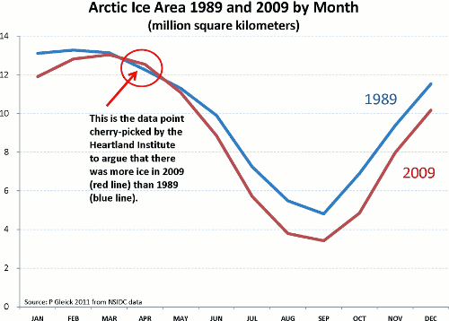
Notes:
Here, a statistical outlier - the one time when the arctic ice cap was larger in 2009 than in 1989 - was used as “proof” against global warming.

Slide 23
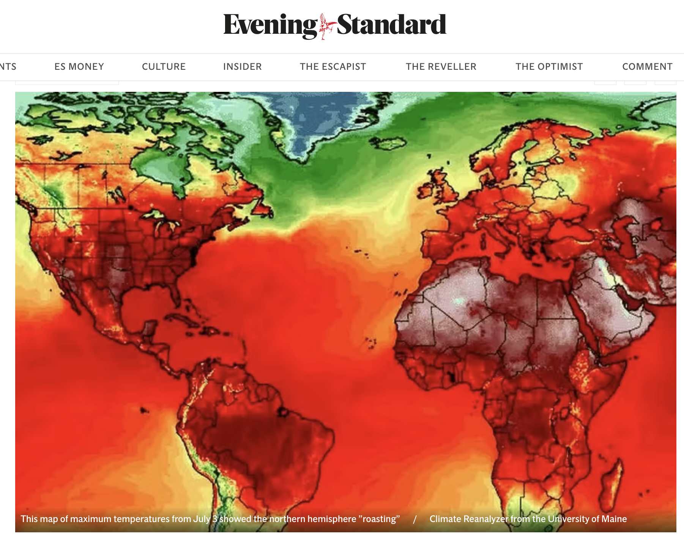
Notes:
Here, the opposite is happening: climate change is not under- but overestimated: the heat wave is exaggerated through the use of dark red color and no scale is provided.

Slide 24
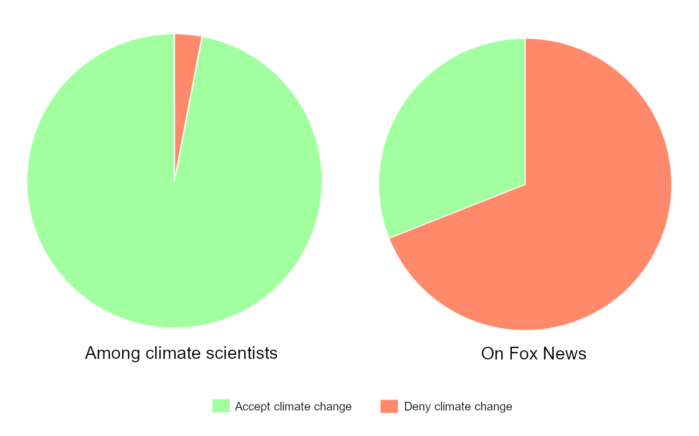
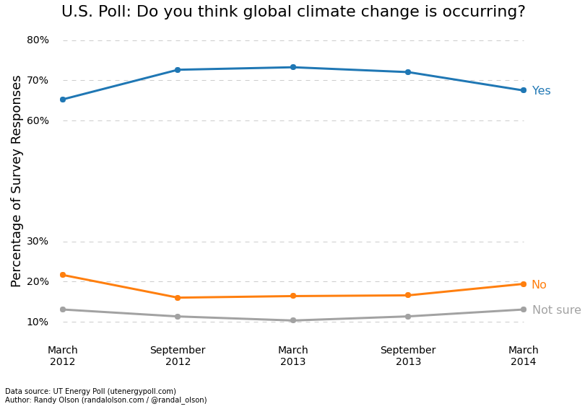
Representation of Climate Change in the Media
Example of Fox News (USA)
Scientific consensus on climate change (left) versus attitudes of Fox News guests in 2013
Source: https://en.wikipedia.org/wiki/Media_coverage_of_climate_change and https://www.theguardian.com/environment/climate-consensus-97-per-cent/2013/oct/23/climate-change-climate-change-scepticism
Notes:
1. Even though these figures are already a bit older, it shows what the problem is when some parts of the media cherry pick and talk disproportionately more about scientists (and studies) rejecting global warming than the rest.
While 97% of the science confirmed man-made climate change in 2013 (today it’s an even higher proportion)…
2. the schewed representation on Fox (and other US media) led more than 20% of the US population to disbelieve or question it.
Even when journalists try to be fair and balanced, they run into a problem with topics like this one in TV talk shows or discussion groups. In a TV studio in 2013, one would have needed 97 scientists confirming climate change sitting opposite 3 that say the opposite (or 32:1) to reflect the ratio of scientist believing one or the other. Unfortunately, they don’t fit into a TV studio.

Slide 25
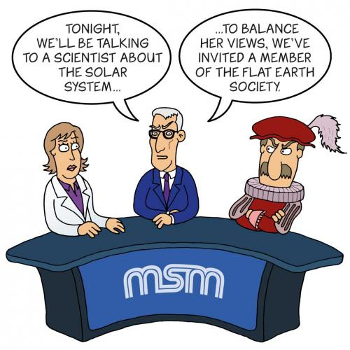
False Balance
Notes:
For journalism and media, this creates the problem of false balance. When you try to give a voice to both sides, even though one side has far less scientific support (eg. climate change, but also Covid 19 debates), you are creating the image that both sides’ arguments are equally valid. On the other hand, if journalists don’t show “the other side”, they are accused of being “mainstream” or “streamlined”.

Slide 26
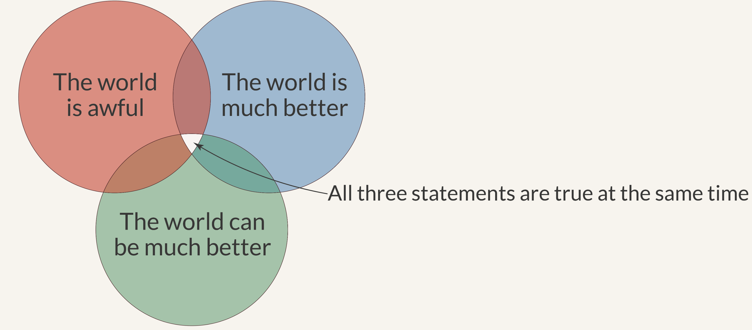
Seeing Things in Perspective
Notes:
Moving on to different subjects…
even if you stick to data that has a solid body of evidence behind it, you can still choose to tell just one side of the story.
https://ourworldindata.org/much-better-awful-can-be-better
Quality journalism will try to give the whole picture… but at the same time, selection is unavoidable, just because there is never enough space or time to write / show everything.
That is why it’s also up to us, the media consumer, to read, watch and listen to various sources… and if we’re really interested in a certain topic, do some wider research.

Slide 27
Confirmation Bias
Notes:
Both journalists and readers are subject to (various extents of) confirmation bias.
Even if you are looking at just the facts… you will be more likely to spot those facts that confirm your beliefs.
(eg again with global warming, if you believe that it is getting hotter every year, you will be more likely to notice and remember the hot days of the Summer than the cool ones - that’s why we need science and statistics - to tell us what’s happening, even if our personal impression is different.)

Slide 28
Quick Recap
So far we’ve seen:
All media messages are “constructed”
Media messages embed points of view
Media messages shape our perceptions of reality
Different audience, different understanding of the same message
Notes:
Quick summary in between…
… now let’s move on to more examples

Slide 29
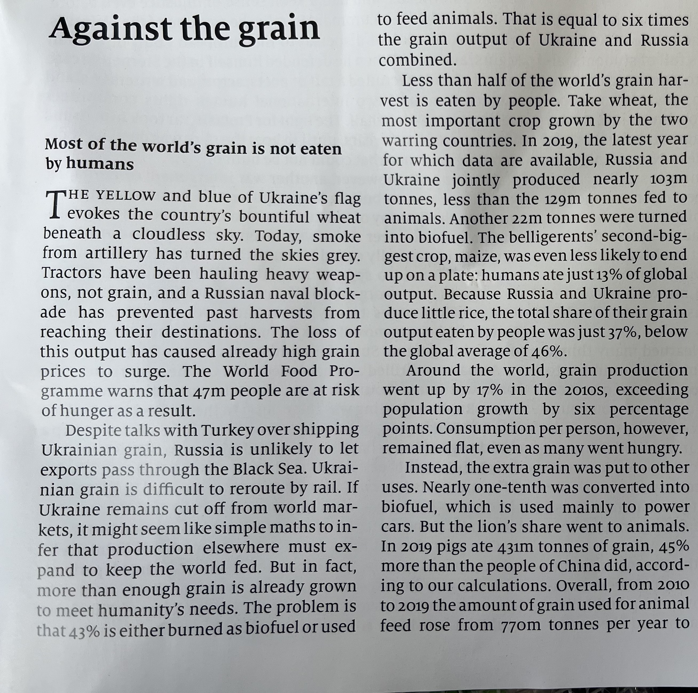
But in fact, more than enough grain is already grown to meet humanity’s needs. The problem is that 43% is either burned as biofuel or used to feed animals.
Notes:
1. A subtle example of selection and framing
Even in quality and fact-based journalism, such as eg. here in the “Economist”, selection and framing can play a role.
Consider this sentence: “But in fact, more than enough grain is already grown to meet humanity’s needs. The problem is that 43% is either burned as biofuel or used to feed animals.”
Again (as in the previous examples), the data and facts are correct.
But given the way “the problem” is presented, you would think that the larger share is being burnt as opposed to being fed to animals. In the text, the percentage value (43%) isn’t divided to say how much is burned and how much is fed to animals.
2. You need to look at the graph to see that of the 43%, almost four times as much is fed to animals (ca. 34%) compared to the amount burnt as biofuel (ca. 9%).
You (and the journalist) could argue that nevertheless, burning food IS the bigger problem (because you feel that feeding animals is better than burning it in cars), but that is a value judgement… and it has influenced - maybe subconsciously - the way the journalist phrased that sentence.

Slide 30
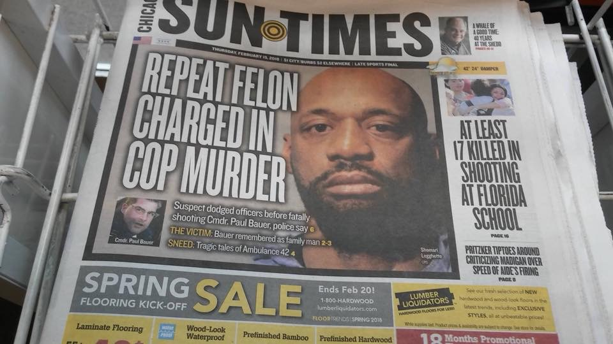
Notes:
From the subtle to the bland: what has gone wrong here?
This newspaper clearly believes that the murder of a policeman by a black man is more important than a school shooting with 17 dead children.
Also, the accused’s face is shown - he is not convicted, only “charged”. This is ethically wrong (innocent until proven guilty) and also against media law (in the USA and UK, the right to inform the public is weighted higher, in mainland Europe data protection and the rights of the individual are usually given more weight. Even so, also in the USA, the alleged criminal could sue this newspaper for slander if it turns out he is innocent.)

Slide 31
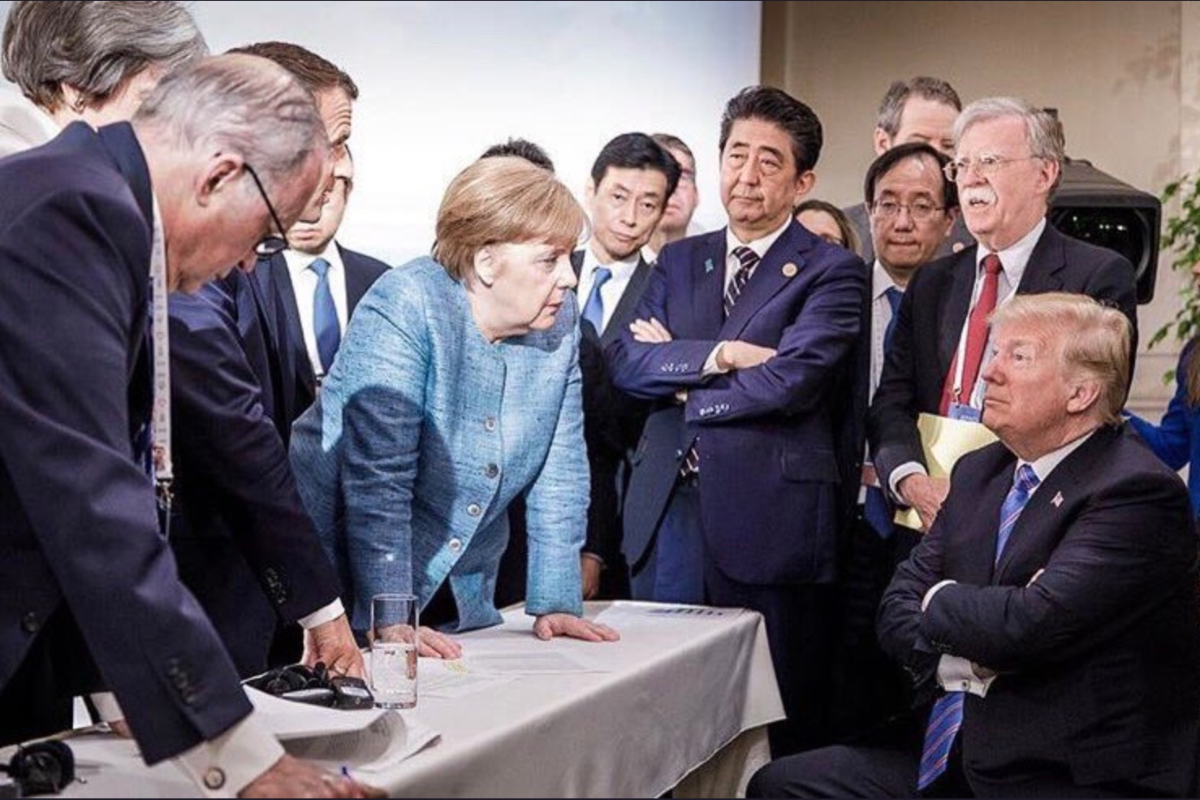
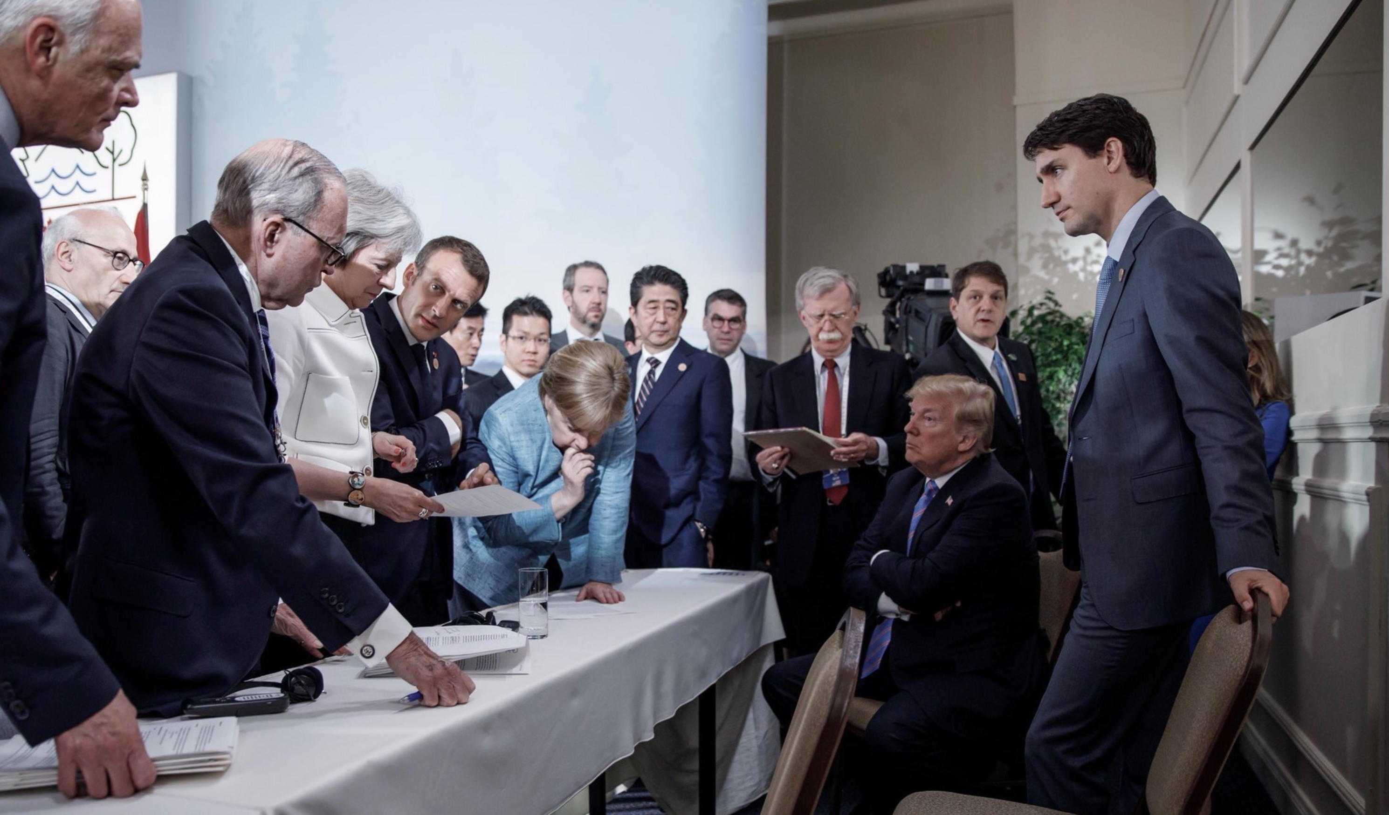
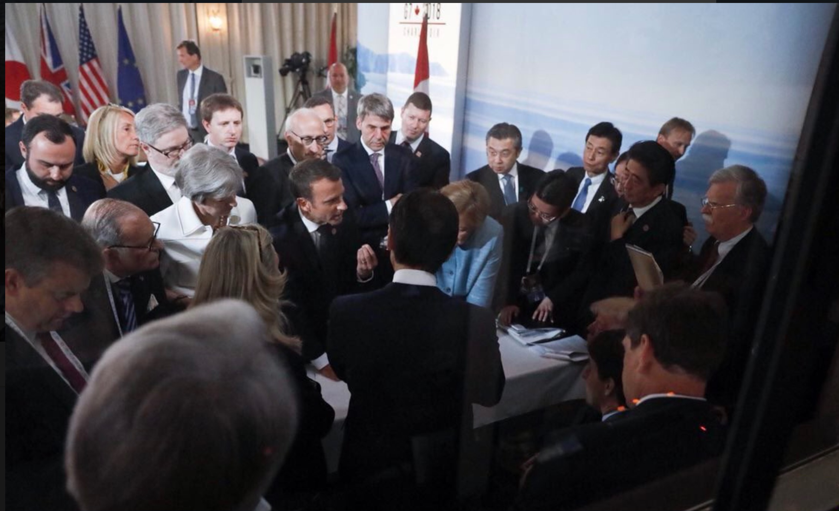
photo taken by:
Merkel’s team
Trudeau’s team
Macron’s team
Trump’s team
G7 summit in Canada, June 2018
Notes:
1. Let’s look at more examples of framing and perspective, this time in photos.
2. 3. 4. Every president’s photographer frames the picture in a different way.

Slide 32
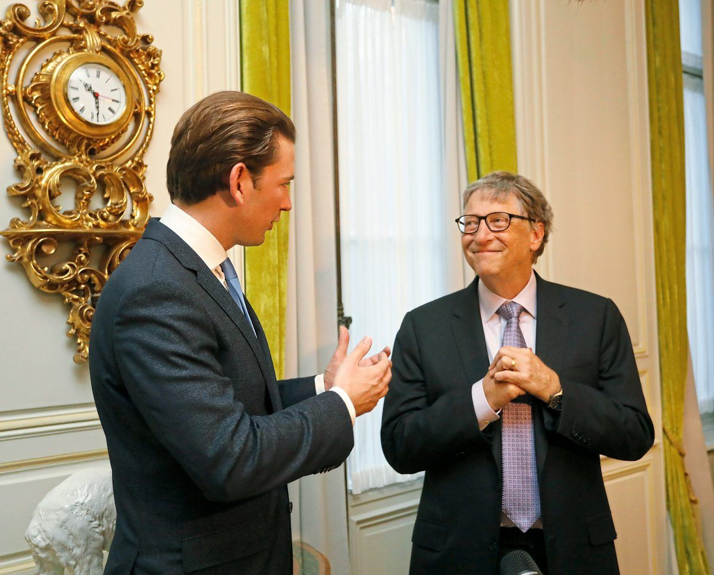
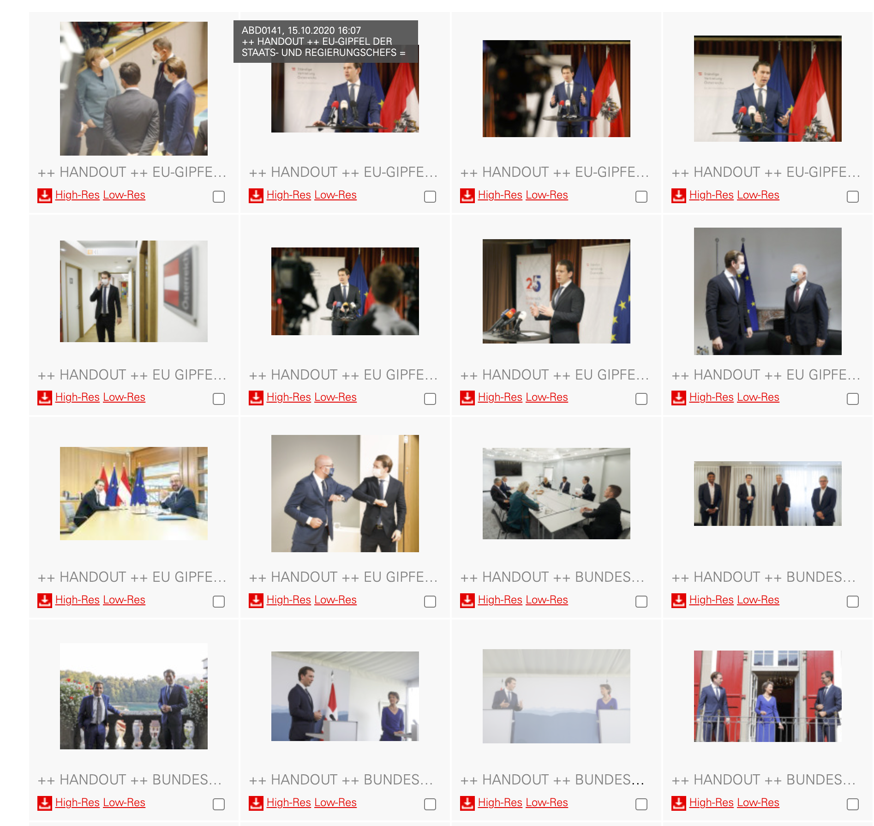
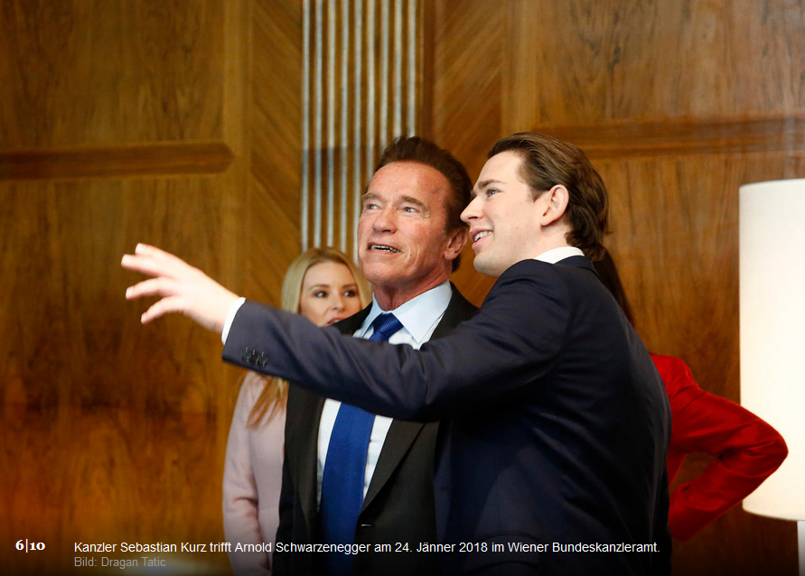
Notes:
The same happens in every country. The photographer of Austria’s ex-chancellor Sebastian Kurz accompanied him to all meetings and sent the “best” photos for the media to distribute.
2. 3. Sebastian Kurz seems to always be the one in charge, explaining the situation / the world to the others.
4. Photos like these are shared to media via the Austrian Press Agency (APA): and you can see when they are coming from the chancellor’s photographer because of the caption “HANDOUT”.
APA also has their own photographers to cover events but due to cost cutting, they often don’t have enough resources to cover all the relevant events. So, often they don’t send a photographer to a Kurz event, because “we will get the photos from his photographer anyway”. But this “service” comes at a price - because this way the neutral media is forced to accept the framing and perspective that the chancellery wants, showing Kurz always in control and leading the way.
https://www.derstandard.at/story/2000097690892/fotograf-tatic-sebastian-kurz-ist-nicht-eitler-als-heinz-fischer

Slide 33
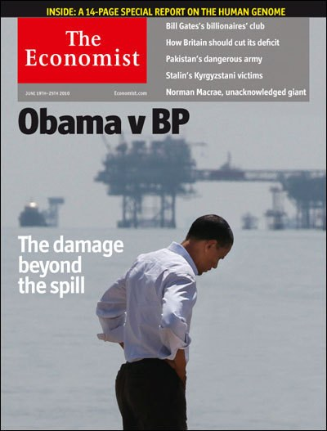
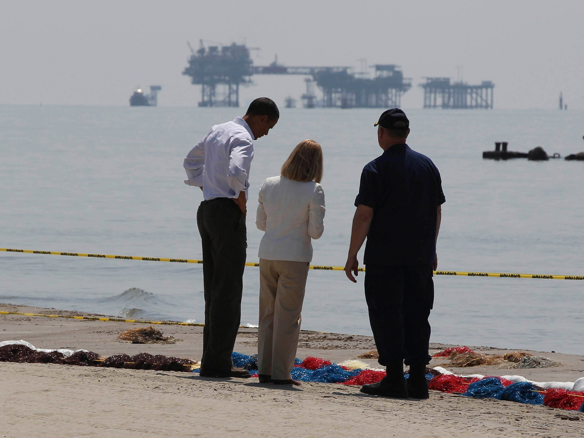
Notes:
More examples of how framing can change the message a photo conveys.
1. Here, The Economist portrayed Obama as alone and rather helpless…
2. The picture looks very different in a wider frame (and they even photoshopped the woman out!)
The Economist later apologised for this kind of manipulation. If they had only reframed the photo, that would have been ethically OK… still, it would have suggested a certain meaning to the reader.

Slide 34
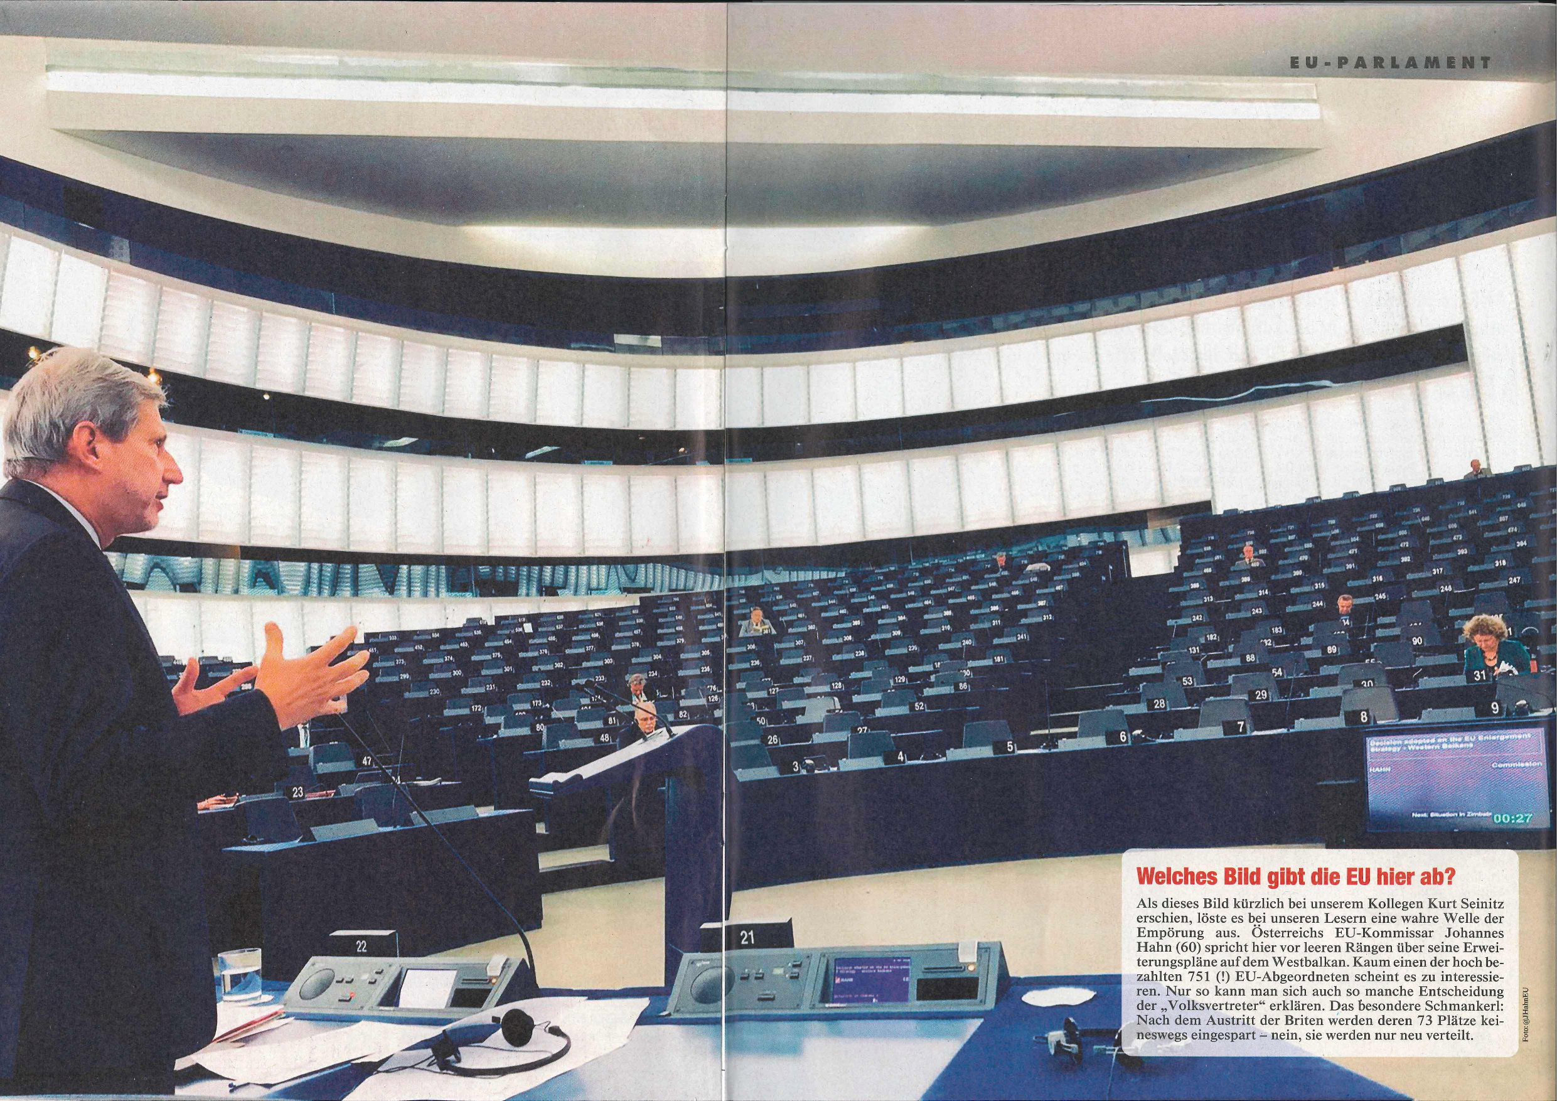
Notes:
Going one step lower on the “quality journalism” scale, this photo taken by Johannes Hahn as European Commissioner for Neighbourhood and Enlargement on the 4th of July 2017 was published in Austrian tabloid newspaper “Kronen Zeitung” and shows a picture of a nearly empty EU parliament, implying that at the EU, nobody is working or taking their work seriously.
In this case, the “selection” is not in what is or isn’t shown or from what angle, but WHEN the photo was taken, accompanied by a misleading text suggesting the EU’s refusal to work.
So what’s the real story? The head of the Austrian EU office wrote a letter to the newspaper explaining that his photo was taken during a committee meeting and not during a parliamentary session. The committee used the parliament because the other rooms were busy with other committee meetings (in total, there were 77 other meetings that day). The newspaper did not respond to the letter nor print a correction of their faulty claim - both are things that quality media should and would do.

Slide 35
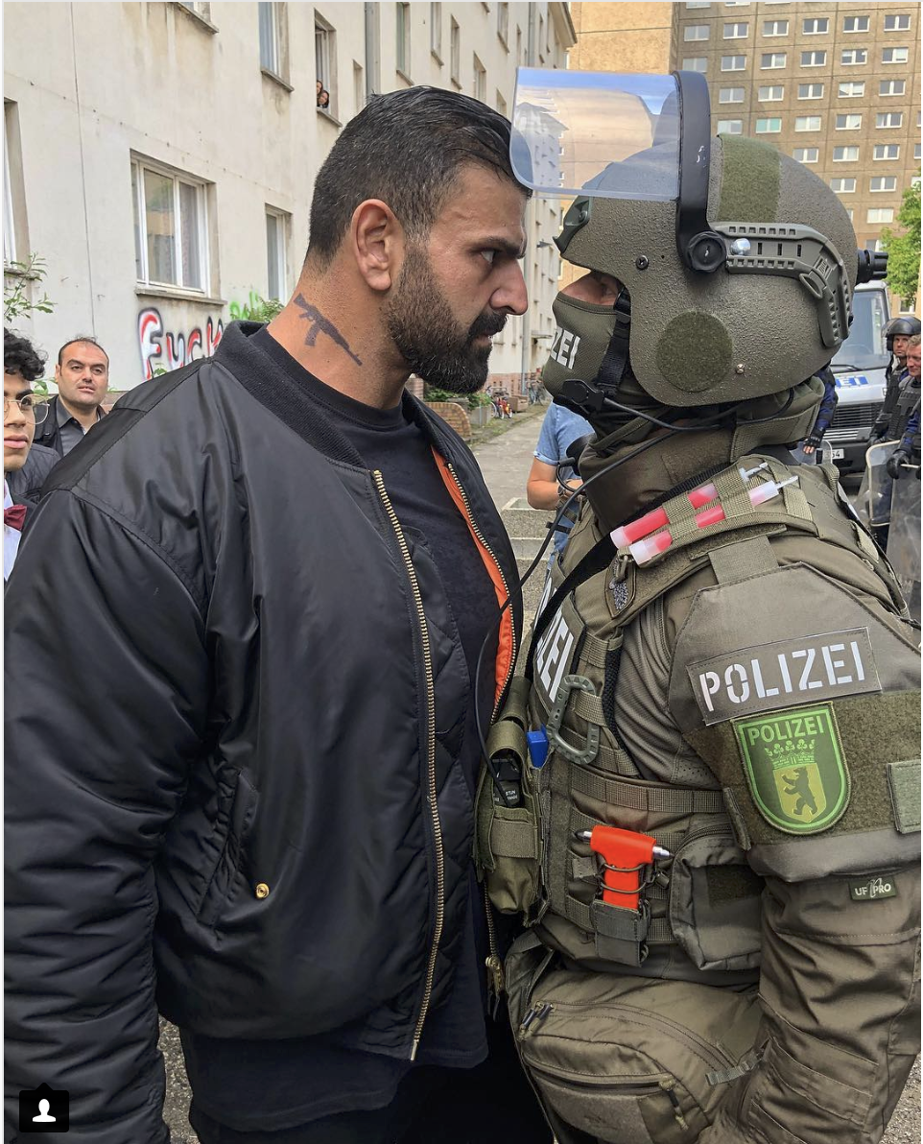
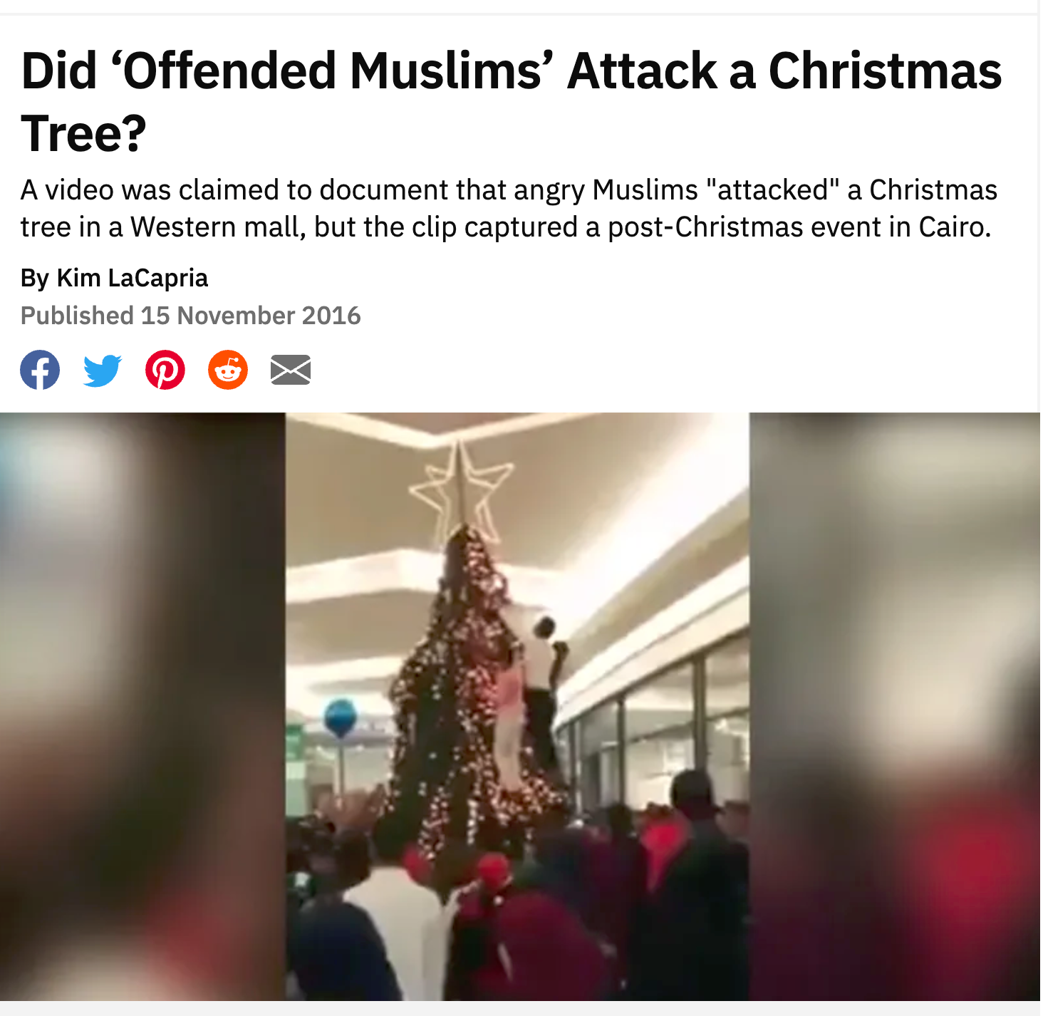
Notes:
1. From the tabloids to fake news on social media…
This photo was used on some social media channels as showing how immigrants defy German police and state authority.
In reality, this is a photo which was taken as a joke on a film set and both are actors.
2. Another example. This video (and another similar one, both of which are no longer online) was widely shared around Christmas for many years on social media in Germany, France, the US and other countries, claiming that Muslims were attacking a Christmas tree in a city near them (eg, Frankfurt, Paris, Seattle).
It turns out that this was a tree in a mall in Cairo 2016 and it was meant to be climbed. The mood was happy and also women and children climbed it. But the videos distributed only showed a part which could be interpreted as people trying to “tear the tree down” and the sound was manipulated to sound “angrier”.
How do we find out if the above two are true? Using reverse image search (eg. with Google Images or Tineye) will help. In case of the Christmas tree, one would find that the photo / video had been taken many years earlier in 2016 (whereas on social media, it was shared many years later implying “this just happened near us”). Also, you would come across fact-checking websites such as snopes.com, which research the entire story:
https://www.snopes.com/fact-check/offended-muslims-attack-christmas-tree/

Slide 36
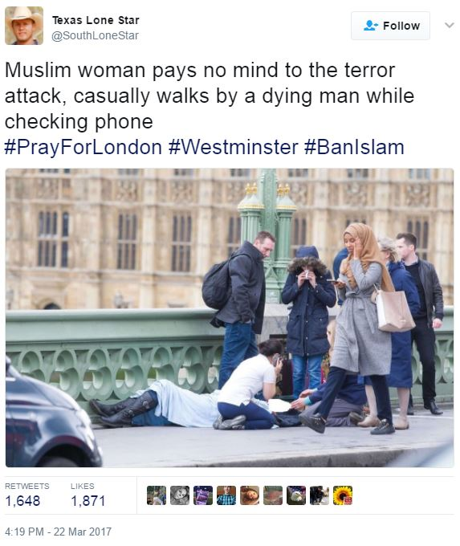
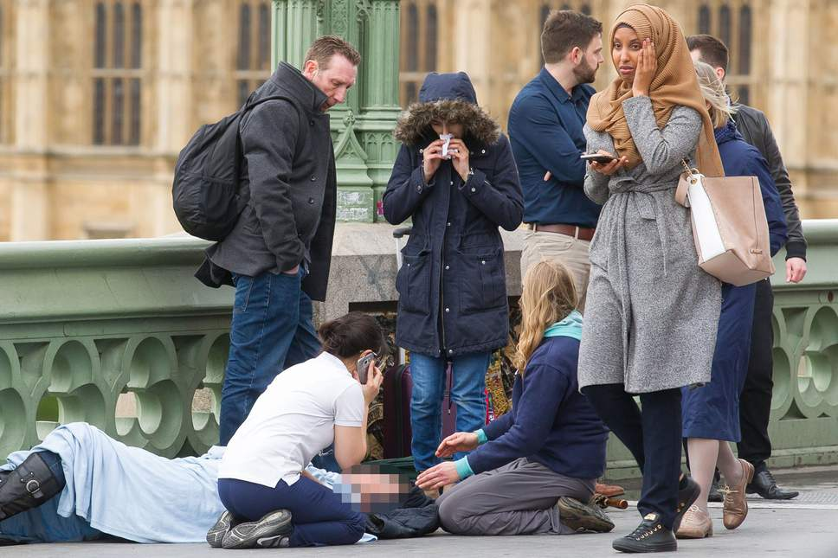
Notes:
1. Here, the selection and framing once again is the time of a photograph. The left image by Texas Lone Star suggests that a presumably Muslim woman is looking at her phone and ignorant of the dying man on the street.
He has precisely picked this photo.
2. Only a split second later (photo on the right), the photo would suggest a different story (the woman looks shocked and concerned).
The woman later issued a statement saying that she was on the phone telling her family that she was alright and that she had previously asked bystanders if she could help. She was shocked that her photo had been abused to convey an image that she didn’t care about what had happened.
Side note: Texas Lone Star, self-proclaimed “Proud TEXAN and AMERICAN patriot”, later turned out to be a Russian bot.
Statement of the woman and more details about this story, see https://mashable.com/article/troll-fake-muslim-picture-westminster-attack-russian-bot

Slide 37
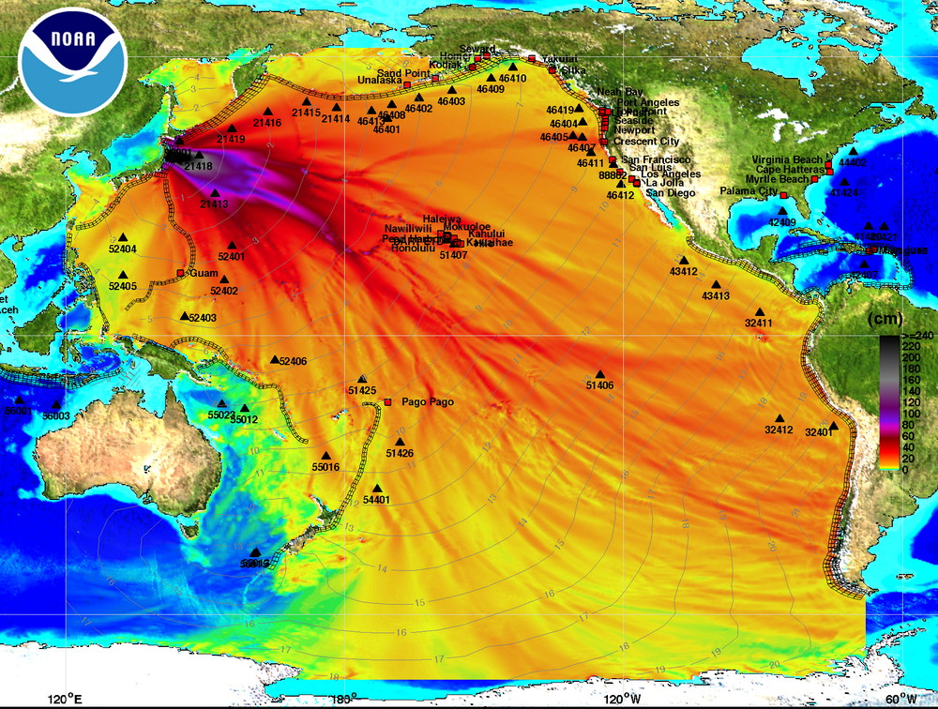
Notes:
Another image widely shared on social media after the Fukushima nuclear disaster, suggesting how much and how far the radioactivity had spread… and how this information is being kept a secret by governments and the mainstream media.
Surprisingly, the correct interpretation is in the image itself - can you find it?
Answer: on the right side, superimposed on South America, is a scale in cm. This image shows the height of the waves of the Tsunami and not radiation levels.

Slide 38
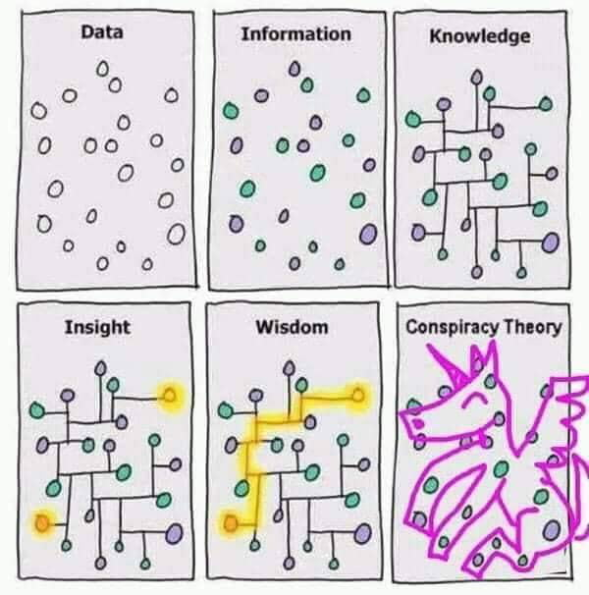
Notes:
So we’ve seen examples of things that are often called “fake news”. In most cases, these heavily misleading pieces of news don’t invent facts or photoshop images… but they are very selective, only picking things that support their story and framing them in a way that best suits them.
Fake news can feed conspiracy theories and vice versa.
When we read an article or watch a video, we only see the lines that the journalist / creator has drawn for us… we usually don’t see the dots behind them. While it is reasonable to trust a journalist / creator to a certain extent (especially from reputable, quality sources), we should always ask: what has been left out of the picture (see also next slide).
(Excerpt on conspiracy theories:
There are reasons why conspiracy theories are so appealing to our brains, but this would be another workshop of it’s own. If you’re interested, I suggest Robert Brotherton’s Book: Suspicious Minds.
Here’s a summary:
"Conspiracy theories fit with a lot of our biases. We're biased towards seeing patterns -- finding meaning -- even if it's not really out there. We're biased towards seeing intentions, rather than just assuming that things happen by accident; we tend to assume that somebody wanted it to happen. We're biased towards thinking that if something big happens in the world it has a big cause. We don't like to think that big events -- like the assassination of a president -- could have been caused by something as insignificant as one slightly unbalanced guy that nobody has ever heard of before. We have lots of these biases that are built into our brains for probably good evolutionary reasons, but a consequence is that sometimes we arrive at mistaken beliefs. Sometimes we might buy into a conspiracy theory regardless of whether it's really true or not." - Rob Brotherton)

Slide 39
What you see is all there is
“What you see is all there is” is a term popularised by psychologist Daniel Kahneman to describe the cognitive phenomenon that our brains are wired to believe that the information we have is all the relevant information there is. This becomes a problem because we tend to not look for what we don't see.

Slide 40
Summary:
Selection and Framing
Journalists must always select what to tell and what not.
Quality journalism will try to select data and examples that are representative of and true to the bigger picture.
Personal beliefs might (subconsciously) influence the way a journalist tells a story.
Poor journalism/biased media will select/cherry pick only those facts that confirm the message they want to relay and/or frame them in a misleading way.
As a media consumer, be aware of tentative framing and always ask: what has been left out of the story?

Slide 41
Summary:
How to critically consume information
Be aware of the powers of selection and framing.
Think about what has been left out of the picture/story.
Watch out for red flags: emotional or suggestive language, etc.
Check other sources - do an internet search.
Evaluate the quality of a media outlet (do they abide by the rules of quality journalism?).
Fact-check with online verification tools.

Slide 42
Fact-Checking
Online Verification Tools
Image reverse search, eg. Google Images, Tineye
Maps, Street View
Internet archive: eg. Wayback Machine
Historical weather search: eg. Wunderground
Fact-checking websites such as “Snopes”
Open data sources, eg. Our World in Data
OSINT (open source intelligence) tools online https://osintframework.com/
Notes:
If you are still not sure whether something is correct or not, eg. because there are few or no other sources reporting on it, you can dive into the world of fact-checking… here’s a selection of some tools that can help
images.google.com
https://tineye.com/
maps.google.com
https://web.archive.org/
https://www.wunderground.com/history (remember Slide 3 when we verified the photos by confirming that the weather was cloudy on that day)
www.snopes.com
https://ourworldindata.org/

Slide 43
Final Thoughts
Most journalists are doing their best (given their resources and limitations) to give you accurate and balanced information.
Be critical of the media but don’t assume “it’s all lies”.
Journalists are humans and everyone can make mistakes: if you are thinking “conspiracy or mistake?”, the chances of it being a mistake are much higher.
Consume quality media from different sources and check if you are not sure about something.
Support and pay for the media you want to consume - thus making them more independent.

