Slide 1
how to:
FACILITATOR: ANA DRAGOMIR
MAKE A MOVE(MENT)
EU DEMOCRACY RALLY
the use of media and message in developping a communication campaign
(advocacy or a form of protest)
LUXEMBOURG 2022

Slide 2
FIRST OF ALL: A BIT ABOUT ME
*Insert information about the facilitator and the experience*

Slide 3
DEMOCRACY WHO?
POWER OF THE PEOPLE
Main pillars of civic engagement
Volunteering
Voting
Activism
Advocacy
TO BE AN ACTIVIST IS TO SPEAK. TO BE AN ADVOCATE IS TO LISTEN.
Society can't move forward without both.
- EVA LEWIS

Slide 4
COMMUNICATION TOOLS FOR
ADVOCACY AND CIVIC ENGAGEMENT

Slide 5
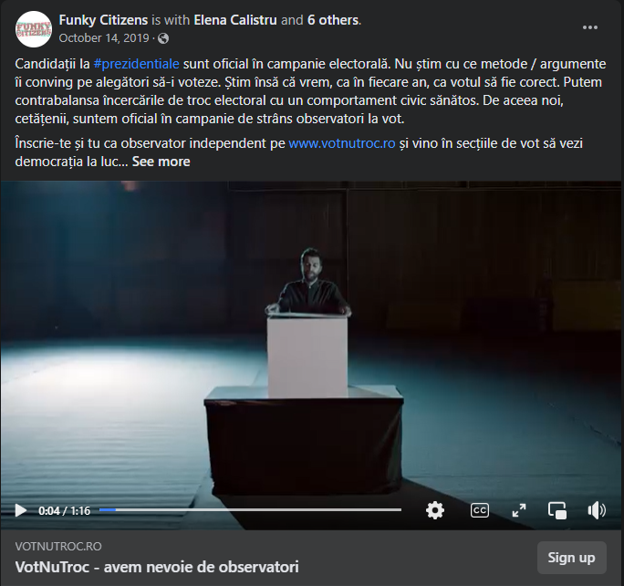
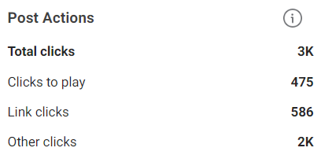
COMMUNICATION TOOLS FOR ADVOCACY AND CIVIC ENGAGEMENT
Social Media campaigns

Slide 6
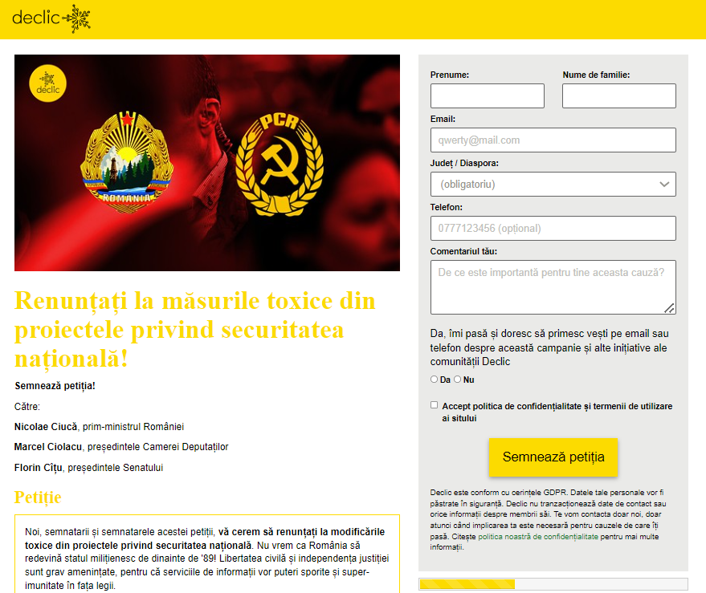
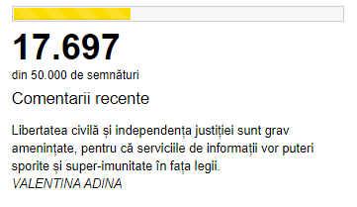
COMMUNICATION TOOLS FOR ADVOCACY AND CIVIC ENGAGEMENT
Petitions (online/ offline)

Slide 7
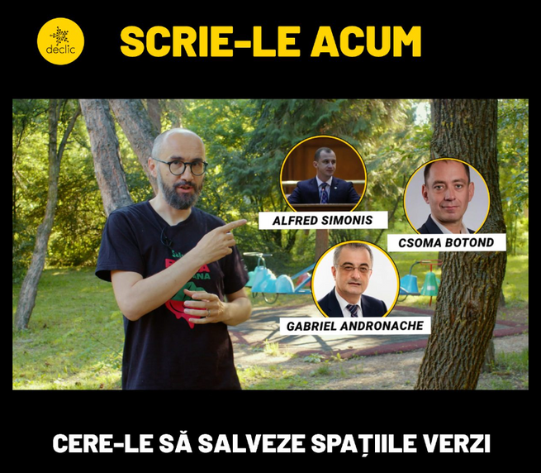
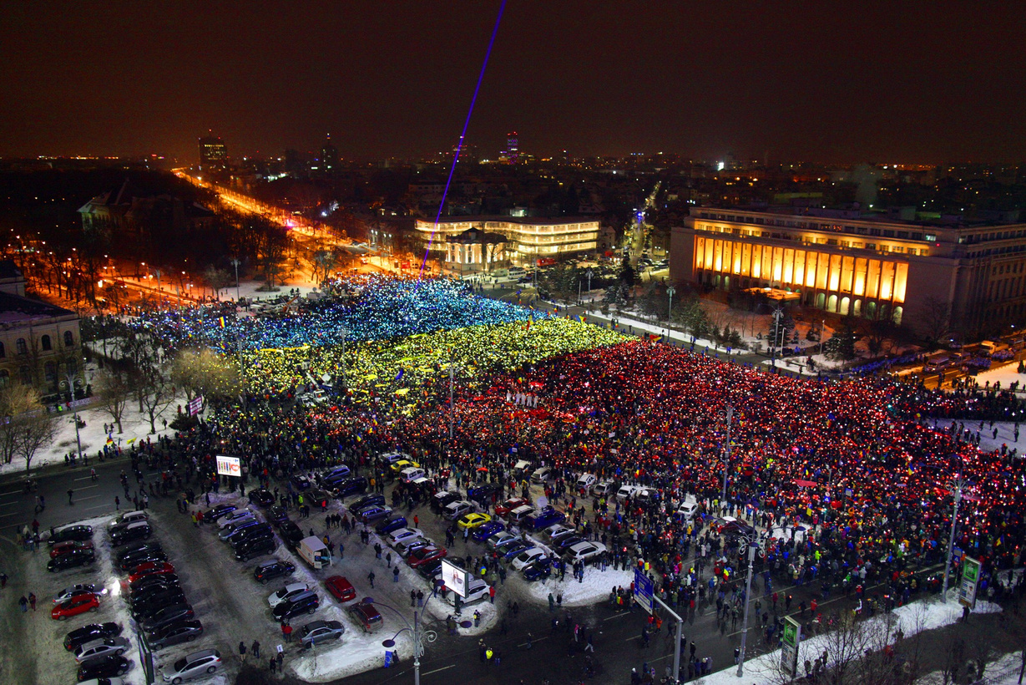
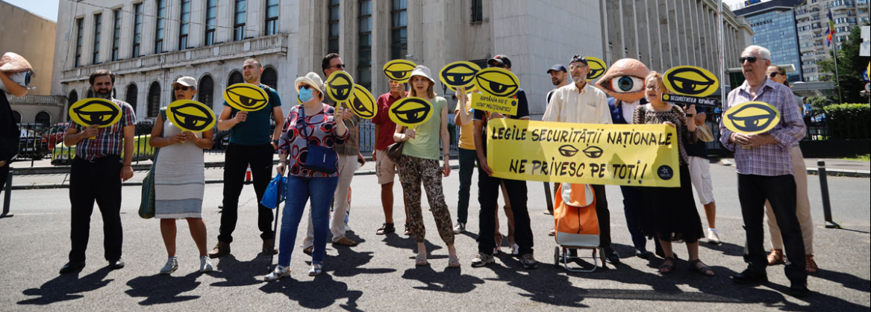
COMMUNICATION TOOLS FOR ADVOCACY AND CIVIC ENGAGEMENT
Forms of protests (boycotts, call to action, street protests, etc)
INQUAM PHOTOS / LIVIU FLORIN ALBEI

Slide 8
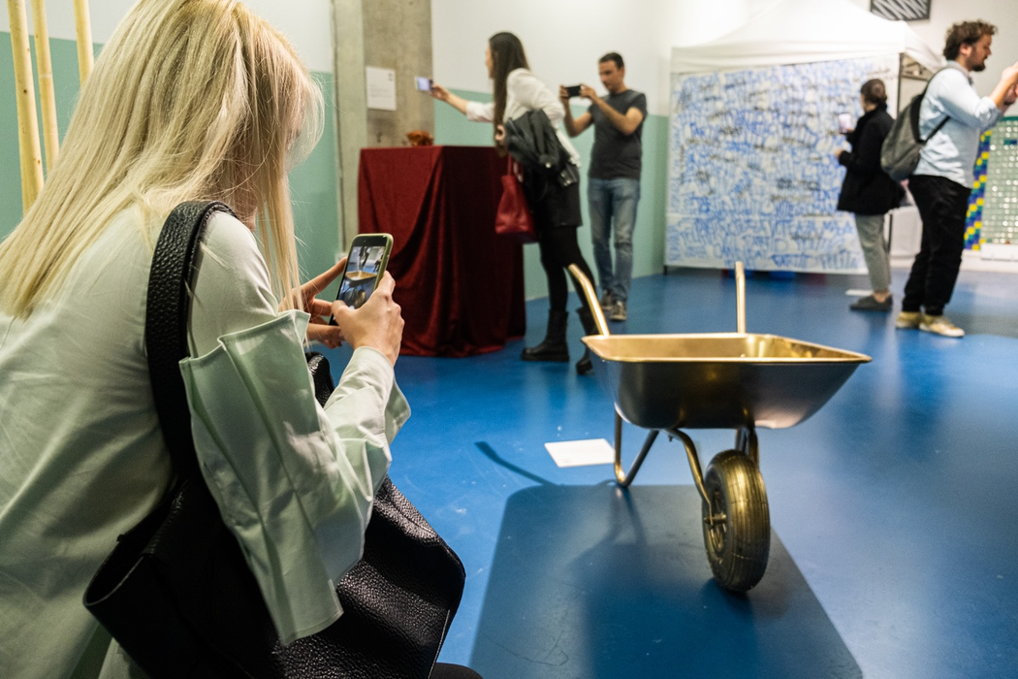
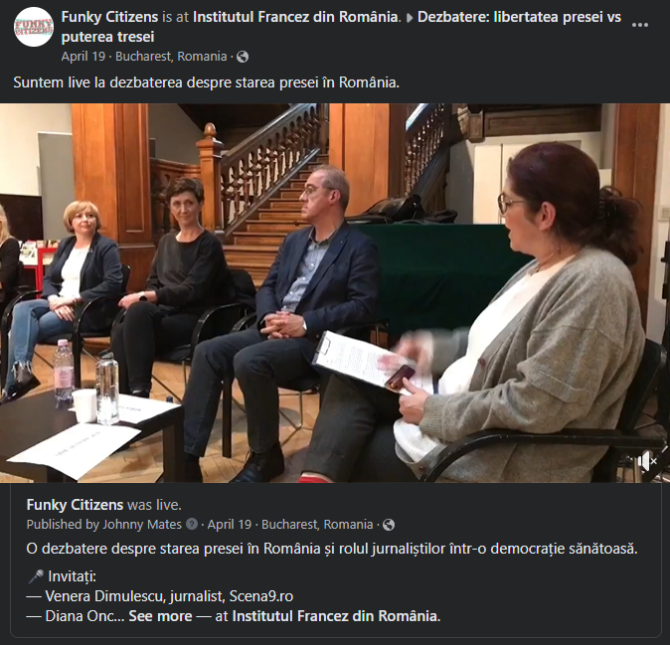
COMMUNICATION TOOLS FOR ADVOCACY AND CIVIC ENGAGEMENT
Events (debates, exhibitions, workshops)
2019 - EXHIBITION WITH OBJECTS USED AS ELECTORAL BRIBE IN REGIONS OF ROMANIA
2022 - DEBATE ON FREEDOM OF THE PRESS

Slide 9
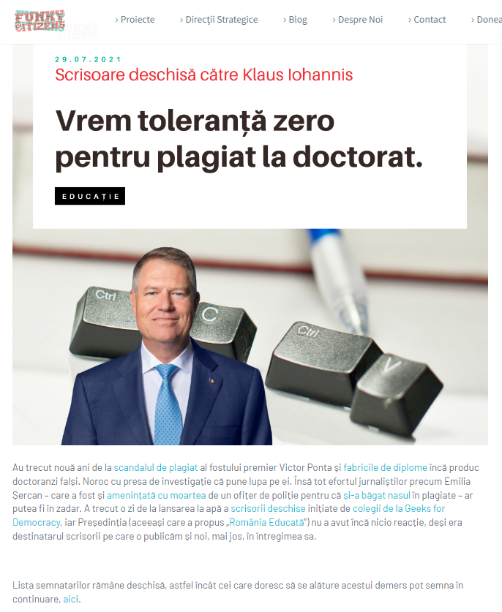
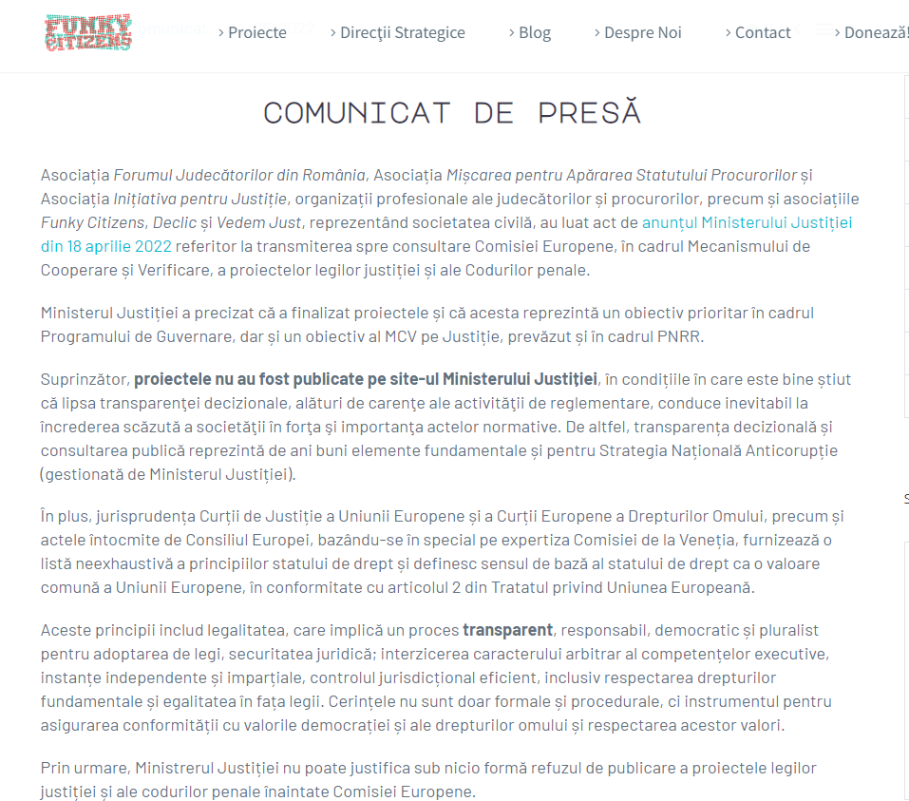
COMMUNICATION TOOLS FOR ADVOCACY AND CIVIC ENGAGEMENT
Open Letters and Press releases

Slide 10
BUT HOW DO YOU MAKE A COMMUNICATION CAMPAIGN?
- crash course -

Slide 11
Identify the cause you want to campaign about
What do you want people to know about it?
What do you want them to do?
What is the big goal of the campaign, how does succes look like?
State the mission and the vision of the campaign
What do you want to achieve
with it?
What are you working towards?
Find your target audience and the types of public
What are the characteristics of your target audience? (persona)
What are their values?

Slide 12
EXAMPLES:

Slide 13
EXAMPLES:

Slide 14
Define your objectives (SMART)
Specific
Measurable
Achievable
Relevant
Time-bound
Define the big goal of the campaign and then break it down into reachable and measurable tasks
Define your key message
Based on the target audience, their values, and your objectives - find the key message that will set the tone of the whole campaign
The message has to be adapted to the kind of public and the kind of stakeholders
Choose your channels
Where will the campaign take place? Will it make use only of social media?
Mainstream media, TV, radio, OOH (out-of-home banners, flyers, posters)?
Events?
Communication activities are constant while running a campaign. Ideas can be adjusted and improved continuously,
but the main vision, objectives, public and key message have to be set in stone before the release.

Slide 15
OUR FOCUS TODAY:
THE MESSAGE. WORDS. CREATIVITY
Facts: the core of the movement, but not the first thing that the public sees
The public sees the message first, the story
Call to action, protests, petitions, advocacy campaigns
often appeal to the emotional side,
not the rational one
MAY 02, 2025

Slide 16
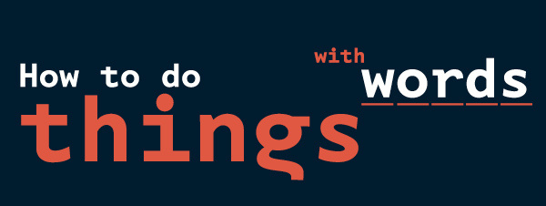
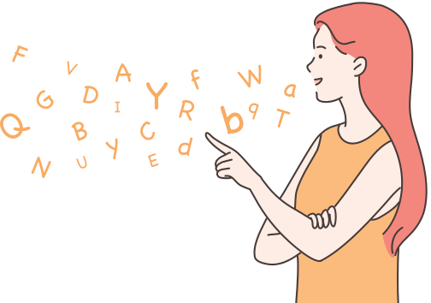
OUR FOCUS TODAY:
- John Langshaw Austin

Slide 17
HOW TO STRUCTURE
AN IMPACTFUL MESSAGE
Identify the target audience and the values you want to use in your message. What is important to them? What can they relate to?
Look at the facts of your campaign, and think of how they make your audience feel.
Less is more, be clear, short
We...
We don't...
Be creative and don't be afraid to be creative
are aware of the facts and information and we reflect them in short, effective messages that will spark the interest of our public
manipulate information in order to convince the audience

Slide 18
Recurring messages:
"United" - togetherness
Party union formed by Podemos, a Spanish party that emerged from a civic movement
Civic group from Romania

Slide 19
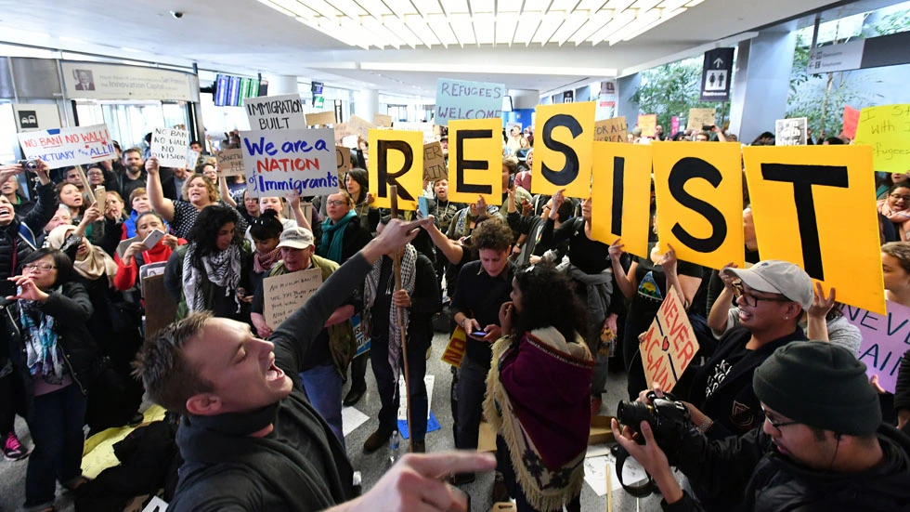
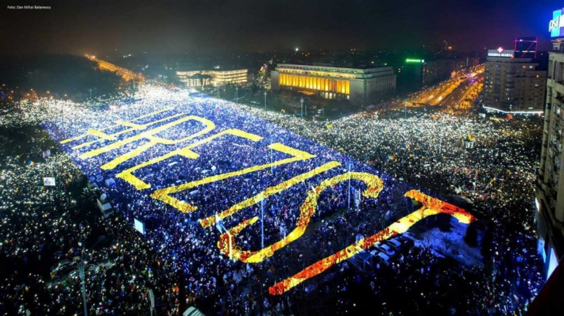
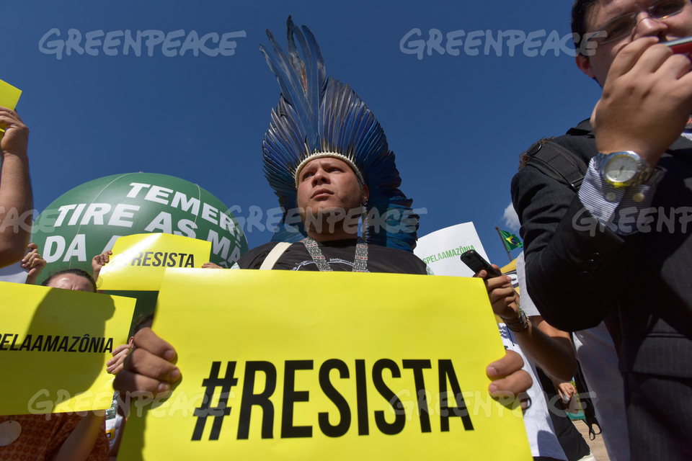
Recurring messages:
Resist - resistance against the corrupt system/ oppressors ("we are not going anywhere")

Slide 20
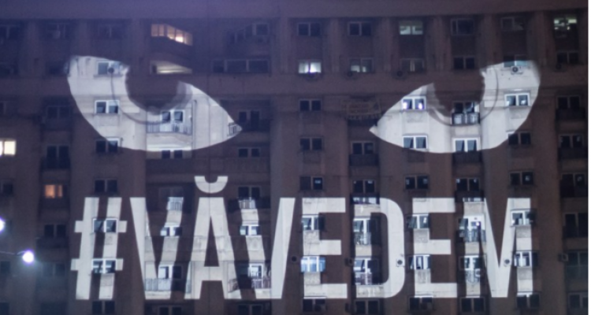
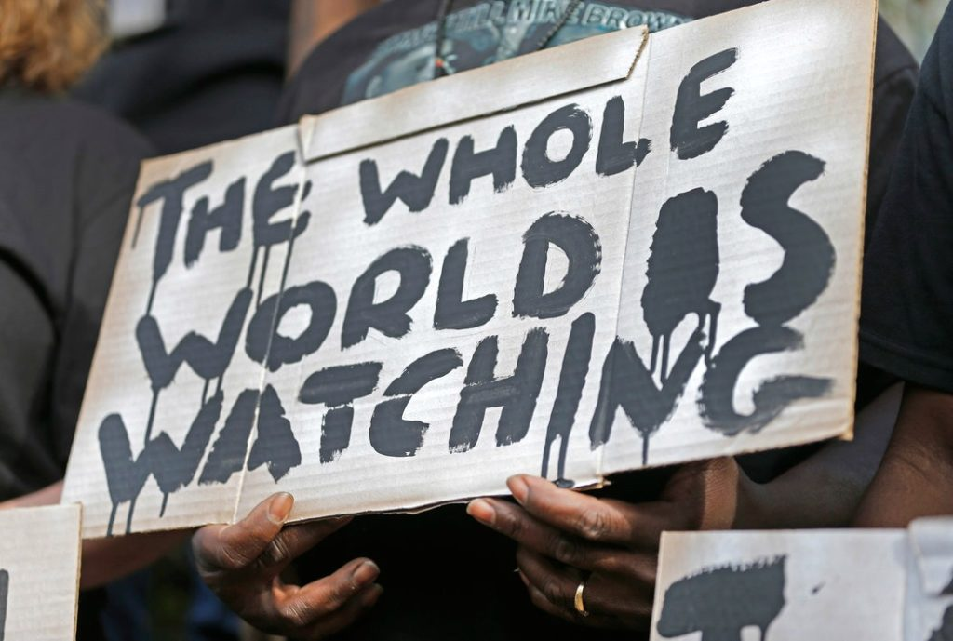
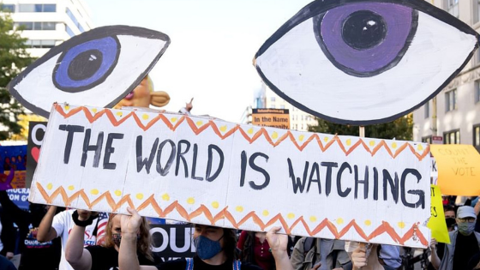
Recurring messages:
We are watching/ We see you
"You will not get away with it" - Watchdog

Slide 21
CAN YOU GIVE AN EXAMPLE OF ADVOCACY CAMPAIGN FROM YOUR COUNTRY?
WHAT WAS THE KEY MESSAGE?

Slide 22
Exercise
Think about a cause you would like to advocate for
Set the big goal of your campaign
Set the target audience (age, gender, urban/ rural, income, beliefs/ values, political orientation, hobbies etc.)
State the vision of your campaign (one/two phrases)
Create the key message of your campaign
(make a short presentation that states it)
Remember, the creation of a message doesn’t come only from creativity, it requires thorough research of the target audience, message testing, and improvement.
But for today we focus on the creative

Slide 23
Discussion session
What was the most difficult part of the exercise for you?
What was the process of creating your message?
How did the team work?
Thoughts on the other mini-campaigns?

Slide 24
FACILITATOR: ANA DRAGOMIR
EU DEMOCRACY RALLY
THANK
YOU
LUXEMBOURG 2022

